Slide 1

Memory, Attention and
Summing Up
How Your Brain Works - Week 13
Prof. Jan Schnupp
wschnupp@cityu.edu.hk
HowYourBrainWorks.net

Slide 2
Types of Memory
Memory
Short Term or
“Working”
Long Term
Procedural
Declarative
Visuo-Spatial
Phonological
Semantic
Episodic

Slide 3
Working Memory
Working memory is thought to be mediated by sustained activity of neurons in prefrontal cortex (PFC) as illustrated in the experiment by Freedman et al discussed over the next few slides.

Slide 4
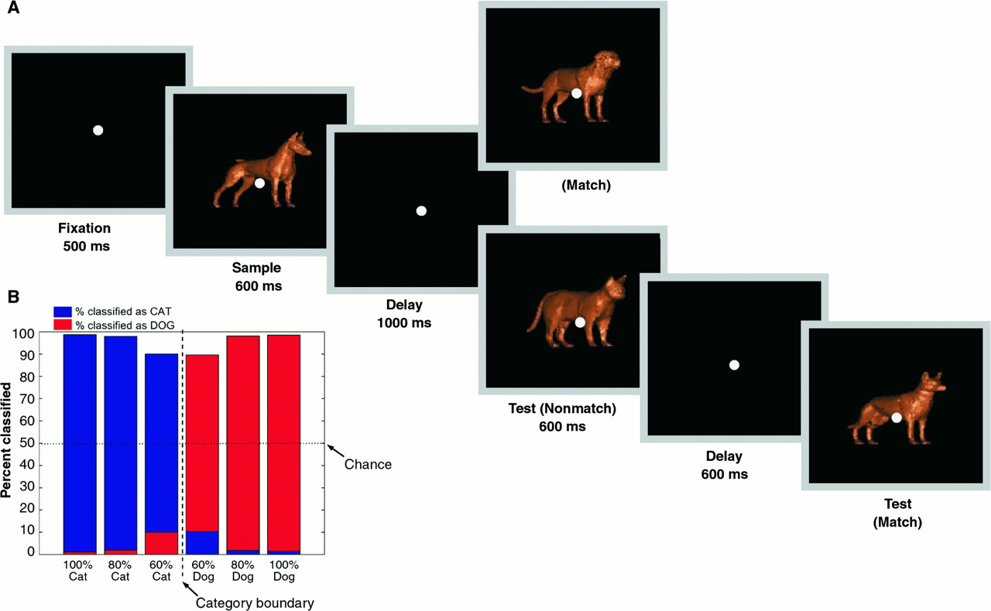
D J Freedman et al. Science 2001;291:312-316, Figure 2:
Task design and behavior. Monkeys were trained to categorize computer images of cats or dogs in a delayed match-to-sample task. To vary difficulty, the images could be “morphed” to be, say, 70% dog and 30% cat. (A) A sample was followed by a delay and a test stimulus. If the sample and test stimulus were the same category (a match), monkeys had to release a lever before the test disappeared. Otherwise, there was another delay followed by a match. Equal numbers of match and non-match trials were randomly interleaved. (B) Average performance of both monkeys. Red and blue bars indicate percentages of samples classified as “dog” and “cat,” respectively.
Notes:
Task design and behavior. (A) A sample was followed by a delay and a test stimulus. If the sample and test stimulus were the same category (a match), monkeys were required to release a lever before the test disappeared. If they were not, there was another delay followed by a match. Equal numbers of match and nonmatch trials were randomly interleaved. (B) Average performance of both monkeys. Red and blue bars indicate percentages of samples classified as “dog” and “cat,” respectively.

Slide 5
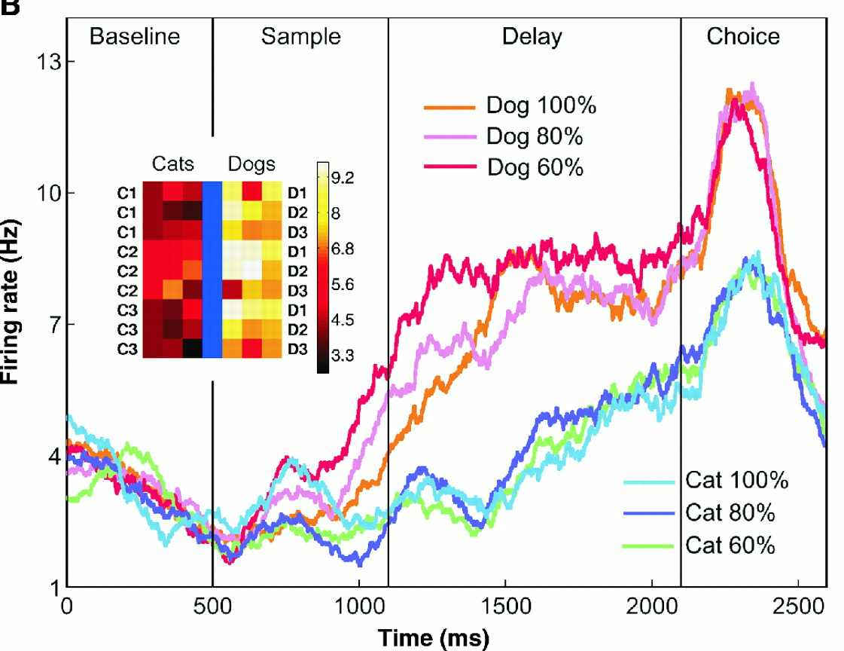
D J Freedman et al (2001)Figure 3B:
The average activity of a single neuron in response to stimuli at the six morph blends. The vertical lines correspond (from left to right) to sample onset, offset, and test stimulus onset. The inset shows the neuron's delay activity in response to stimuli along each of the nine between-class morph lines. The prototypes (C1, C2, C3, D1, D2, and D3) are represented in the outermost columns; each appears in three morph lines. A color scale indicates the activity level.
Notes:
Recording locations and single neuron example. (A) Recording locations in both monkeys. A, anterior; P, posterior; D, dorsal; V, ventral. There was no obvious topography to task-related neurons. (B) The average activity of a single neuron in response to stimuli at the six morph blends. The vertical lines correspond (from left to right) to sample onset, offset, and test stimulus onset. The inset shows the neuron's delay activity in response to stimuli along each of the nine between-class morph lines (see Fig. 1). The prototypes (C1, C2, C3, D1, D2, and D3) are represented in the outermost columns; each appears in three morph lines. A color scale indicates the activity level.

Slide 6
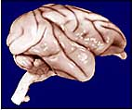
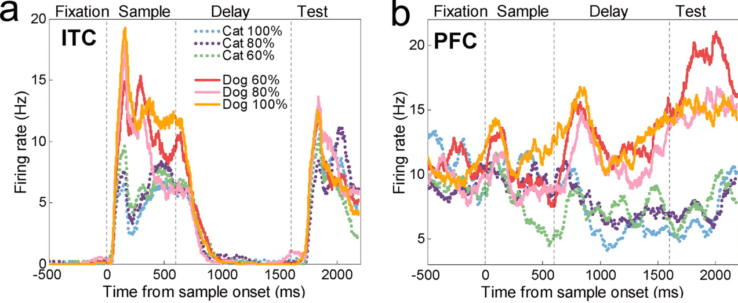
Comparing ITC and PFC
Neurons in the infratemporal cortex (ITC) had learned to distinguish the picture categories. They are active when the stimulus is present.
Neurons in the PFC hold the last seen picture in memory. Their activities are different from the end of stimulus presentation until the monkey responds.
Notes:
Source of macaque brain http://chronicle.uchicago.edu/040429/brainsize.shtml
Source of recording data http://neuro.cjb.net/content/23/12/5235/F3.expansion.html

Slide 7
Forming Long Term Memories with Synaptic Plasticity

Slide 8
Long-term Memory
For “procedural” type learning and memory, see last lecture.
For “declarative” and spatial memories, welcome to the world of “patient H.M.”:

Slide 9
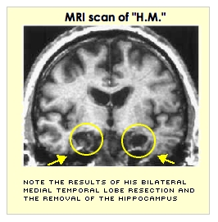
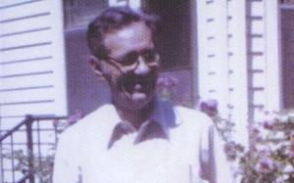
Patient HM
Henry Molaison had his hippocampus removed bilaterally in 1953 to treat severe epilepsy.
He died in 2008.

Slide 10
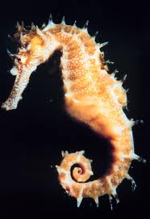
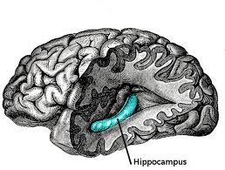
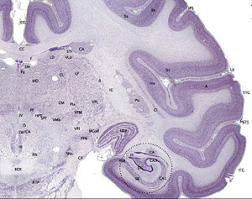
The hippocampus
Notes:
Gray 739
Wikipedia seahorse image
Macaque brain slice image from brainmaps.org via http://www.websters-online-dictionary.org/definitions/Hippocampus?cx=partner-pub-0939450753529744%3Av0qd01-tdlq&cof=FORID%3A9&ie=UTF-8&q=Hippocampus&sa=Search#922

Slide 11
Patient HM
The surgery successfully cured his epilepsy, but left him with severe anterograde amnesia.
He could no longer form new episodic memories. For example, he would not be able to remember people he met just hours before.
He could not learn new landmarks to help him orient in a new environment.
But his ability for procedural learning remained in tact. He learned to play ping-pong after his surgery. Could not remember ever having played it, but became quite good at it.

Slide 12
What does the hippocampus do?
The hippocampus probably has “limbic” roles related to anxiety and depression too, but in this lecture we focus on episodic and spatial memory roles.
It is generally thought that Long Term Potentiation (LTP) following “Hebb’s Rule” is an essential ingredient for the hippocampus’ key role in memory formation.

Slide 13
Hebb’s Rule
“Cells that fire together, wire together”
Psychologist Donald Hebb first suggested that connections between neurons that are simultaneously active might be strengthened.
This is advantageous for “associative learning”. (Associations form between things that are simultaneously signalled in the brain.)
Strengthening (or “long-term potentiation” - LTP) of simultaneously activated synapses has been observed in hippocampus (and later many other brain structures).

Slide 14
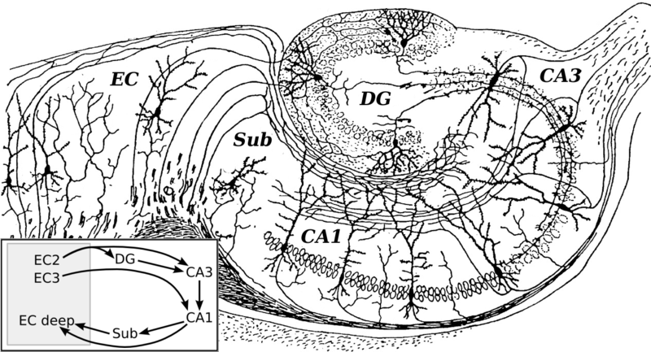
Structure of the hippocampus
Hippocampus receives high level multisensory information via enthorinal cortex (EC)
Inputs go to dentate gyrus (DG), then cornus ammonis (CA) region 3 then CA1 and then back to EC via the subiculum.
The synapses are glutamatergic and plastic.
Notes:
Cajal hippocamous from http://en.wikipedia.org/wiki/File:CajalHippocampus_(modified).png

Slide 15
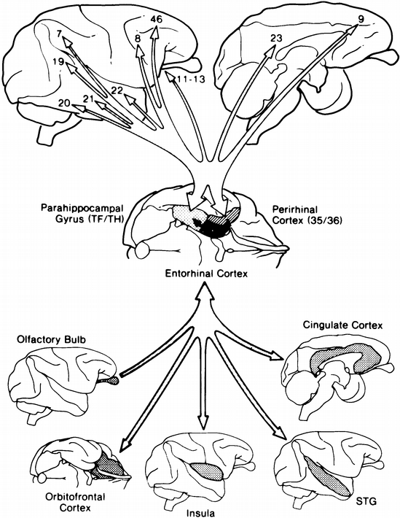
Inputs and outputs from hippo-campus
Notes:
From From “Memory and the Hippocampus,” p. 227, by L. R. Squire, A. P. Shimamura, and D. G. Amaral, in Neural Models of Plasticity: Experimental and Theoretical Approaches, edited by J. H. Byrne and W. O. Berry, 1989, New York: Academic Press. Copyright 1989 by Academic Press, Inc.
Via http://psycnet.apa.org/journals/rev/102/3/419.html

Slide 16
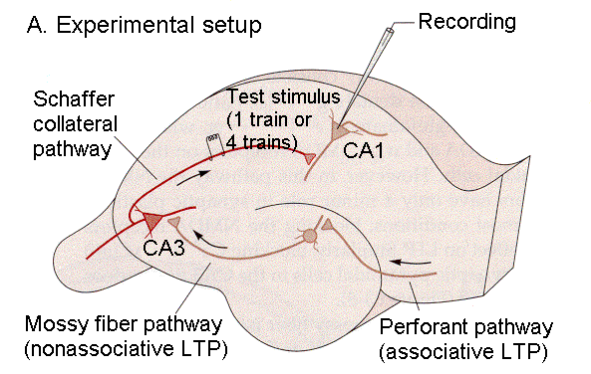
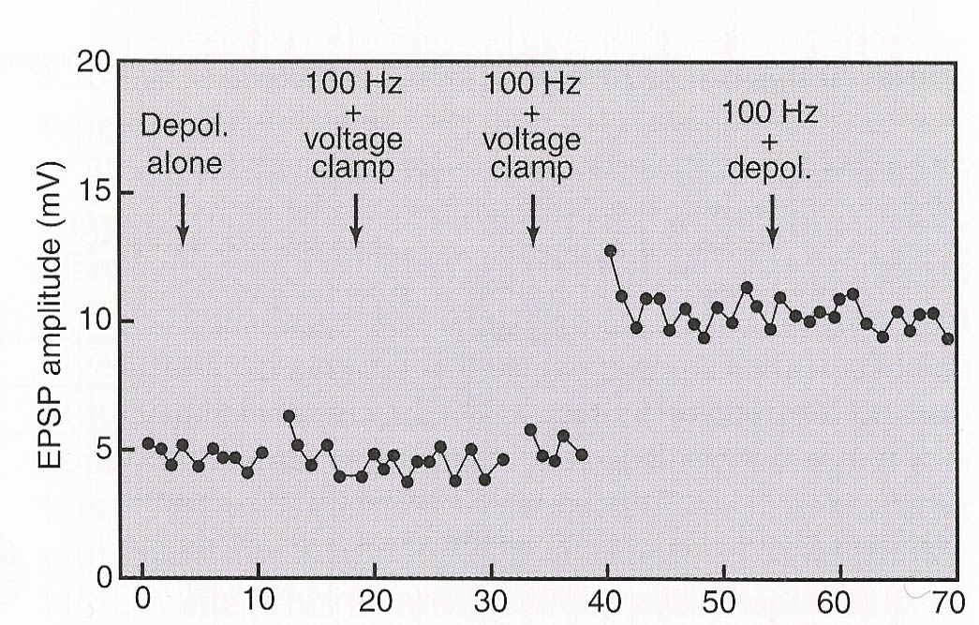
An Example of Hippocampal LTP
Time (min)
EPSPs recorded in hippocampal CA1 cell.
100 Hz stimulus bursts applied to “Schaeffer collateral” inputs, either under voltage clamp or with simultaneous depolarisation.
If the input bursts are paired with depolarisation, the EPSPs are “potentiated” (i.e. larger).

Slide 17
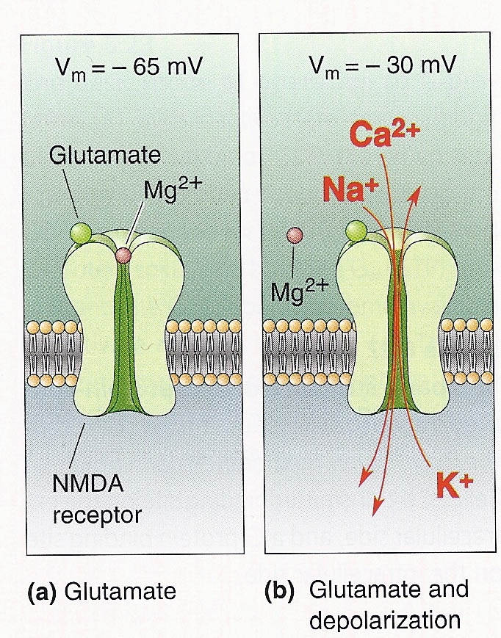
The NMDA Receptor
NMDA receptors appear to be critically involved in LTP at glutamatergic synapses.
NMDA receptor channels open only if glutamate binds AND depolarisation removes a Mg++ from the channel’s pore. This implements Hebb’s rule. The postsynaptic neuron must be active already for the synapse to be modified.
Drugs that block the NMDA receptor (AP-5, MK-801, ketamine) prevent LTP.

Slide 18
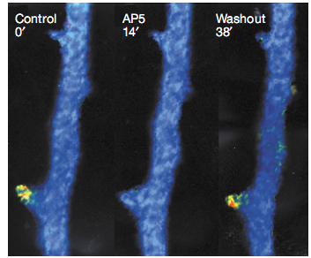
NMDA receptor activation lets Ca⁺⁺ in
Dendrite filled with Ca⁺⁺ indicator “calcium green” emits a flash of fluoresecent light at synaptic spine when synapse is activated.
The fluorescence is inhibited by NMDA receptor blocker AP5
Fig 7 of Lisman et al Nat Rev Neurosci 2002 Vol 3 p 175

Slide 19
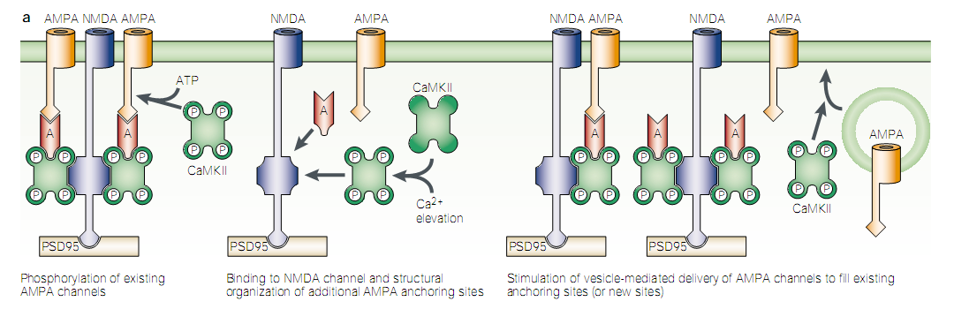
LTP increases AMPA currents
Ca++ activates Calcium/Calmodulin Kinase II (CaMKII)
CaMKII increases AMPA currents in 3 ways:
It phosphoryaltes AMPA channels
It anchors AMPA channels at the postsynaptic membrane
It favours the insertion of further AMPA receptors in the membrane
Fig 7 of Lisman et al Nat RevNeurosci 2002 Vol 3 p 175

Slide 20
Why might Hebb’s Rule be useful?
Let’s consider how “associative learning” via the Hebb Rule in a neural network might support “recognition memory” where seeing only a part of something (e.g. your friend’s favourite t-shirt) might remind you of the whole.

Slide 21
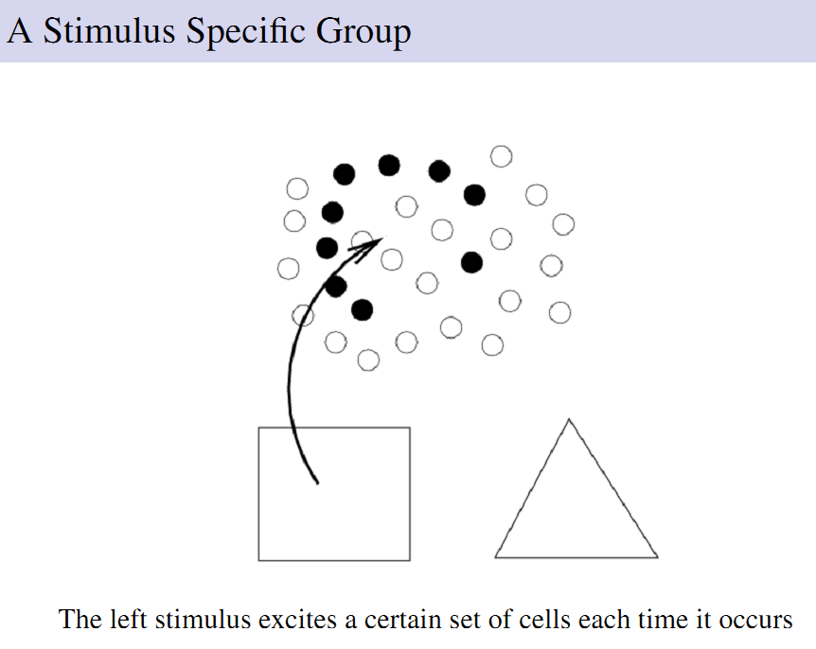

Slide 22
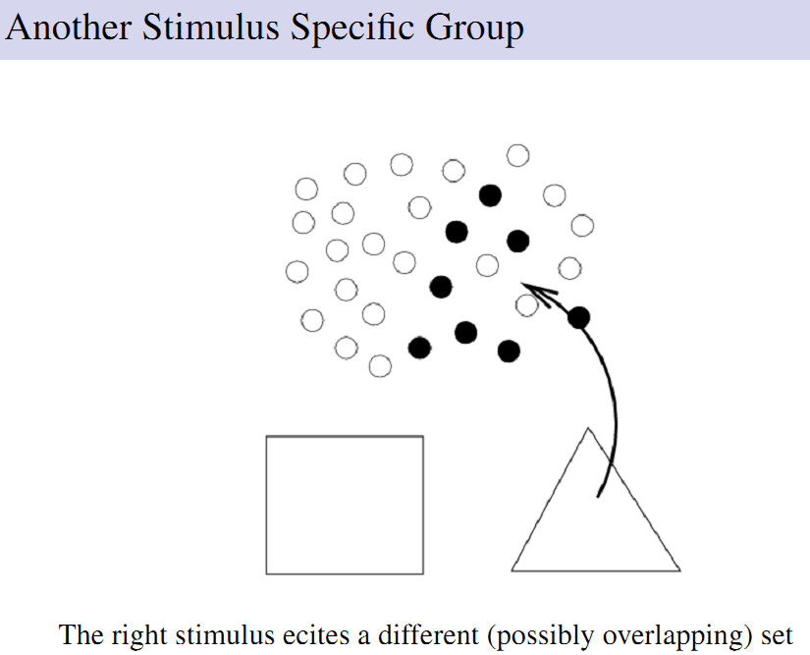

Slide 23
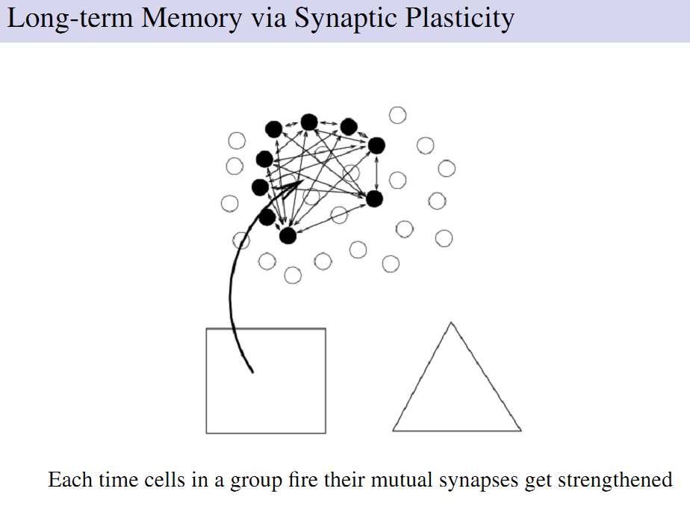

Slide 24
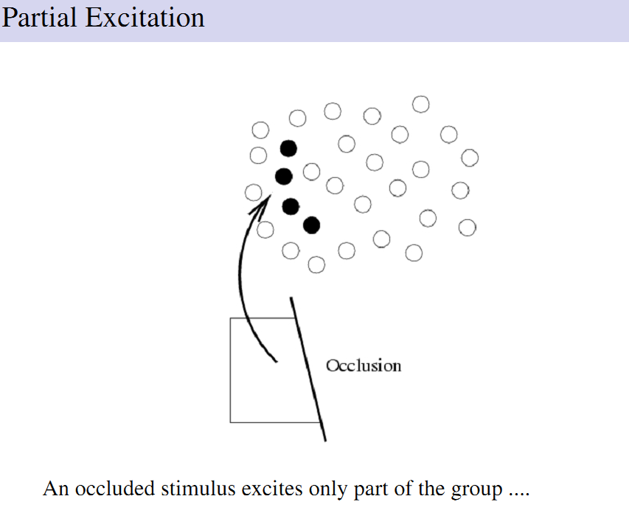

Slide 25
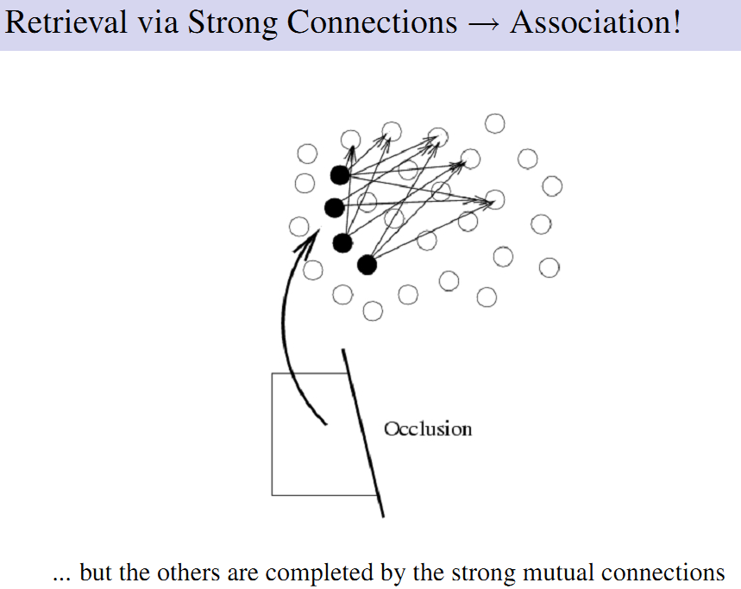

Slide 26
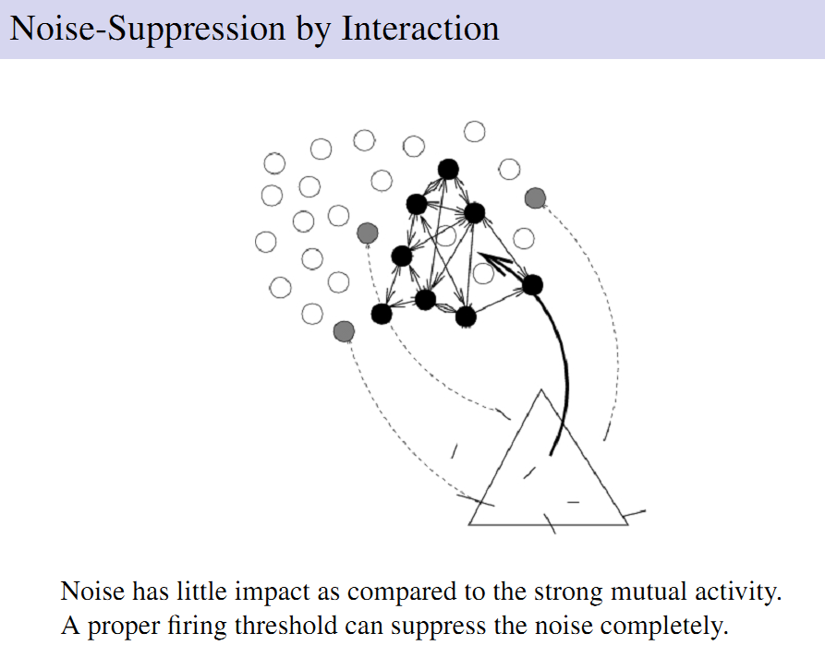

Slide 27
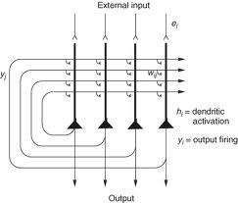
Auto-associative nets
Notes:
http://wires.wiley.com/WileyCDA/WiresArticle/wisId-WCS1.html

Slide 28
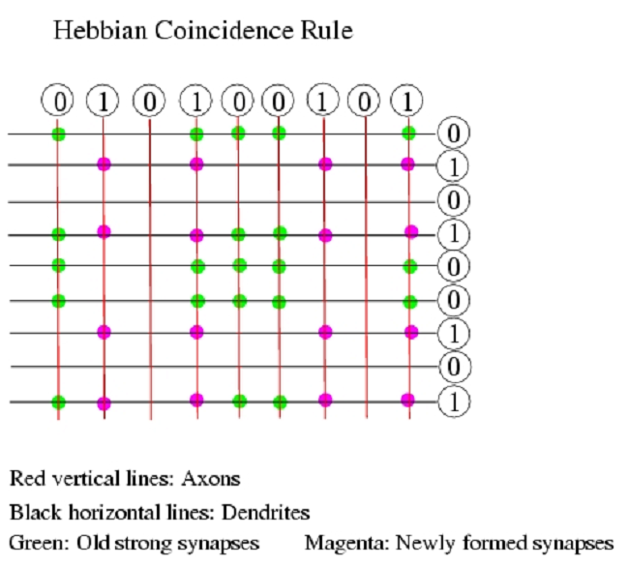

Slide 29
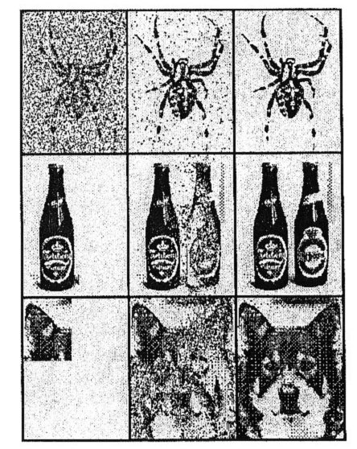
Computer simulations using artificial neural networks illustrate the pattern completion and noise robustness properties that can be achieved with auto-associative memory networks.
Source: Hertz, Krogh and Palmer “Theory of Neural Computation”

Slide 30
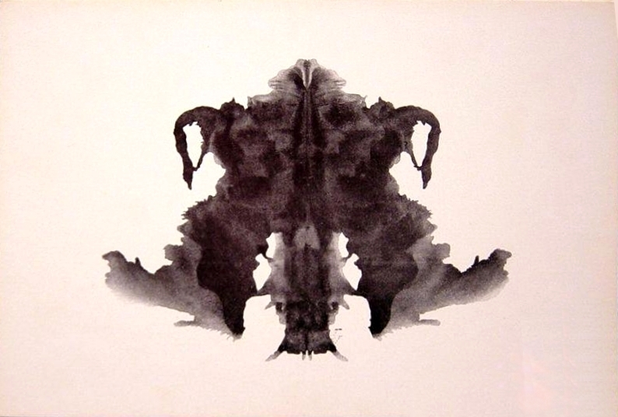
What does this remind you of
A Rorschach Blot
Notes:
http://en.wikipedia.org/wiki/File:Rorschach_blot_04.jpg

Slide 31
Break

Slide 32
“Distributed representations”
In artificial neural networks trained to recognize or recall images, the information is not “stored” in any one place, but distributed widely across the connection pattern between the artificial neurons.
No individual synapse or neuron plays a particularly important role, the activity patterns of individual neurons in the network can be very hard to interpret, and in fact a fair proportion of neurons can be removed without obvious loss of performance (“graceful degeneration”).
So you don’t need, or expect, so called “grandmother cells”: single neurons which “represent” or “recognize” highly specific concepts or objects.
So who asked for Jennifer Aniston neurons?

Slide 33
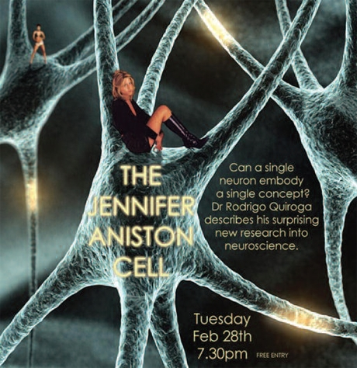
“Jennifer Aniston neurons” were discovered by Rodrigo Quan-Quiroga in hippocampal recordings obtained from human epilepsy sufferers in the clinic of Yitzak Fried.
Note that Quan-Quiroga does not think of his neurons as “one-ofs”.

Slide 34
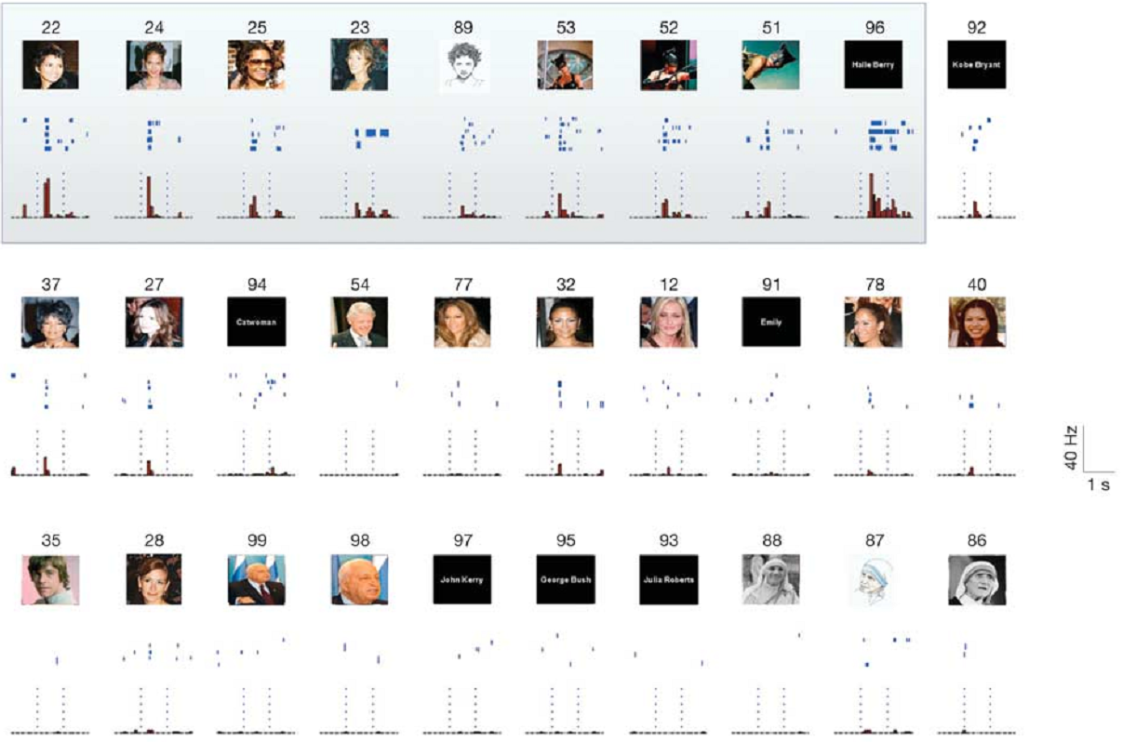
A “Halle Berry” neuron
Notes:
Invariant visual representation by single neurons in the human brain
R. Quian Quiroga1,2,5, L. Reddy1, G. Kreiman3, C. Koch1 & I. Fried2,4
Nature 435, 1102-1107 (23 June 2005)

Slide 35
Episodic memories
It is probably best not to think of “Jenifer Aniston” neurons as proof that the brain works with “grandmother cells”. Rather, they show that the hippocampus receives “sparse, high level, multisensory feature representations” of the environment, and it can combine these with spatial information to form memories of what happened when and with whom.
Hippocampal “place cells” are thought to represent spatial location. They were discovered by John O’Keefe, using “tetrode” recordings from the hippocampus of freely moving rats.
The discovery won him the Nobel prize.

Slide 36
Combining Objects with Places as a Memory-Trick
In the “memory palace” or “method of loci” technique, people imagine a list of objects that they want to remember as placed along a path through a familiar environment, such as their family home.
In your imagination you walk through the chosen place and imagine the objects in prominent locations. When you later wish to recall the list, just imagine walking through the same route and “see” the objects where you had placed them in your imagination.

Slide 37
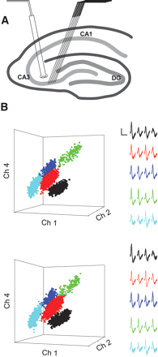
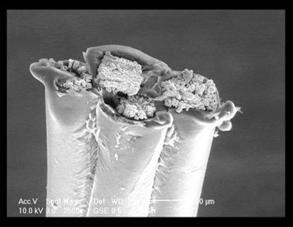
Tetrode recordings
Notes:
http://www.bristol.ac.uk/phys-pharm/research/staffresearch/mattjones.html

Slide 38
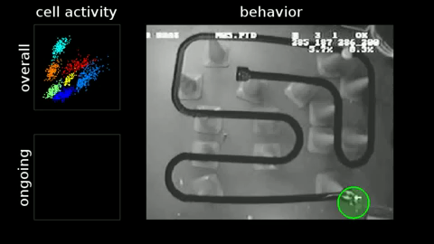
Place cells
Place cells were discovered by John O’Keefe and Bruce McNaughton in the early 70s. John O’Keefe won the Nobel Prize for this discovery.
The video shows recordings of rat hippocampal place cells made in Matt Wilson’s lab at MIT.
Remarkably, recordings from sleeping rats from Wilson’s lab suggest that rats “revisit” places they have explored in their dreams, as place cells fire in sequence when they sleep. This may be related to memory consolidation during sleep.
Notes:
http://www.youtube.com/watch?v=lfNVv0A8QvI

Slide 39
Testing Spatial Memory with a “Morris Water Maze”
The Morris Water Maze is a popular technique to test spatial memory in rodents (rats or mice).
The “maze” consists of a basin filled with “milky” water (water that has a dye in it to make it opaque).
The water is too deep for the animals to stand, except at one point where a small platform is hidden, submerged just below the water surface.
If made to swim repeatedly in the basin, animals with good memory usually learn to remember quickly where the platform is hidden and will search for the platform in the appropriate quadrant. Animals with poor memory will continue to swim aimlessly through the basin even after repeated experience.

Slide 40
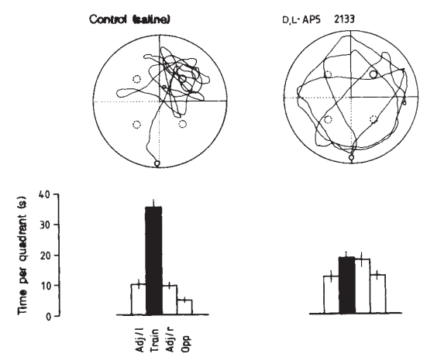
NMDA receptor antagonists can impair the ability to learn spatial landmarks
Rat brains injected with either saline (control) or NMDA antagonist AP5.
Rats trained in Morris water maze task.
Control rats learn to remember where the submerged platform is, AP5 treated rats don’t.
Morris et al Nature 319, 774 - 776 (1986)

Slide 41
Sleep and memory consolidation
Participants in a motor sequence finger-tapping task show similar sleep-dependent improvement, correlated with late-night stage 2 non-REM sleep.
From Stickgold (2005) Nature

Slide 42
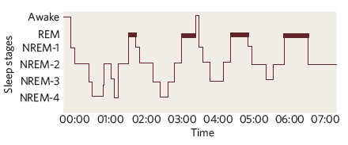
Sleep phases and memory
Procedural memory (such as finger sequence tasks) benefits from slow wave and REM sleep.
Declarative maze running or water maze performance benefits particularly from REM sleep.
The role of sleep in learning declarative items such as vocabulary is less clear.

Slide 43
Forgetting
Memory is due to widely distributed patterns of changed synaptic connectivity.
Memories can be lost either through degradation or through interference.
Some degradation is normal, but certain pathological conditions can hasten memory loss and cause retrograde amnesia or dementia.

Slide 44
Korsakoff’s Syndrome
Between 10% and 24% of cases of dementia in the UK are estimated to be alcohol related (Kopelman et al Alcohol and Alcoholism Jan 2009).
Alcohol can damage the brain directly as well as by inducing thiamine (vitamin B1) deficiency.
The mammillary bodies are often particularly affected.
Notes:
http://www.oasas.state.ny.us/AdMed/FYI/wernickefyi.cfm

Slide 45
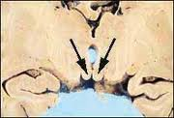
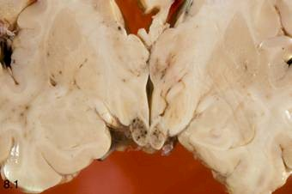
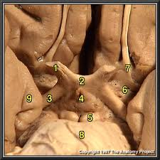
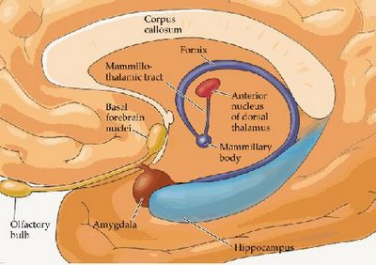
The Mammilary
Bodies
Notes:
http://www.oasas.state.ny.us/AdMed/FYI/wernickefyi.cfm

Slide 46
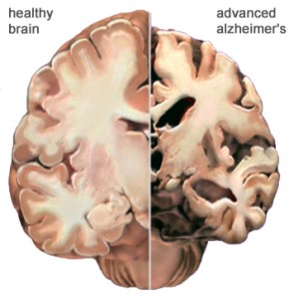
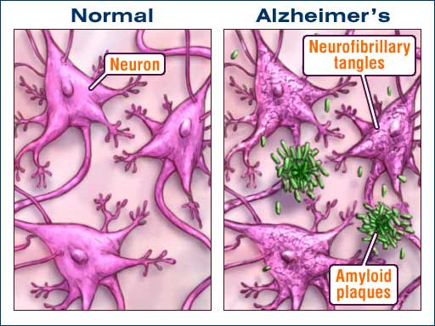
Alzheimer’s Disease
Thought to affect 10% of over 60 year olds and 20% of over 80 year olds.
Cause unclear. Treatment accordingly extremely difficult.
Notes:
http://www.pharmas.co.uk/blog/understanding-alzheimers-disease
http://www.intelligentdental.com/2010/08/23/cold-sores-and-alzheimers-disease/

Slide 47
How the Brain Works
(putting it all together)

Slide 48
Recapping from Previous Lectures
Electrical and chemical signalling in nerve cells is used to link sensory input to motor output.
The link can be very simple (unconditioned stretch reflex), moderately complex (conditioned reflex) or highly complex (“cognitive” tasks).
Motor
Output
CNS
Sensory
Input

Slide 49
Recapping from Previous Lectures
The central nervous system is composed of many subsystems that are organized in a hierarchical manner.
Generally, more complex the “sensory input → behaviour mappings” require more involvement of “higher order centres”.
Cortex
Cerebellum
Midbrain
Sensory
Input
Motor
Output
Sensory
Input
Brainstem
Motor
Output
Sensory
Input
Spinal Cord

Slide 50
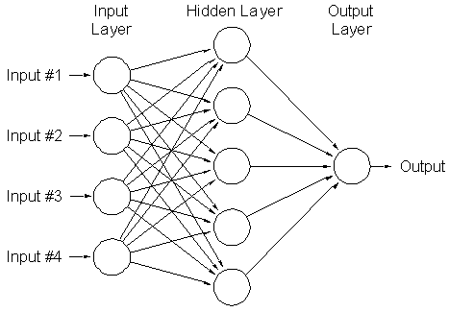
Recapping from Previous Lectures
Synaptic connections along the neural pathways can perform computations by summation of excitatory and inhibitory inputs and divergent and convergent connection patterns.
Many synapses are modifiable, allowing connection patterns, (and hence the function of neurons) to be shaped by experience.
Examples we considered included early visual development, reinforcement learning and episodic memory formation.

Slide 51
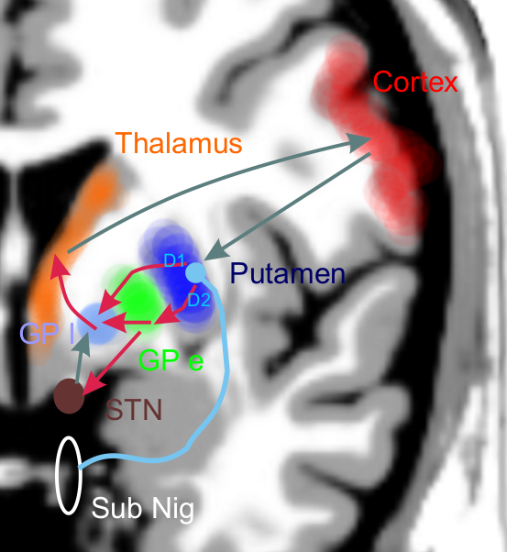
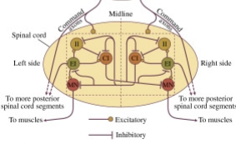
Recapping from Previous Lectures
Neurons in many parts of the central nervous system are highly spontaneously active, and are parts of networks that are wired up “recurrently” (i.e. in loops).
In other words, nerve impulses could in principle come about for apparently no good reason at all, keep going round and around endlessly through countless parallel loops, and may trigger spontaneous (pointless?!) action.
Remember the dyskinetic patient we saw in an earlier lecture? Or the spinal pattern generators?
Motor
Output
CNS

Slide 52
Recapping from Previous Lectures
The “loops” through the brain provide key short- and long term memory functions, and are subject to regulation by “neuromodulator” (dopamine, noradrenaline …) and hormonal (leptin, ghrelin, oxytocin,…) systems. In this manner they link experience and emotional and physiological states into our action patterns.
Internal State
“Memory”
Motor
Output
CNS
Sensory
Input

Slide 53
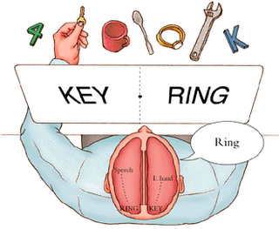
Split-brain Patients and the Conundrum of the Single “Me”

Slide 54
What “unifies” the massively parallel and widely distributed brain activity into an apparently single “mind”?
We don’t know for certain, but:
  the single, unified “self” is probably much more of an illusion than we normally admit to ourselves, and
  Being able to focus attention on “one thing at a time” probably helps.

Slide 55
Competitive (“Winner Take All”) Networks

Slide 56
Backprojections in Sensory Pathways
Cortex
Connections along sensory pathways tend to be two-way.
Descending connections can outnumber ascending connections.
In the case of hearing, backprojections go all the way back to the cochlea.
Midbrain
Brainstem
Spinal Cord

Slide 57
Attention Retunes Sensory Receptive Fields :-
Experiments by Shamma and Colleagues

Slide 58
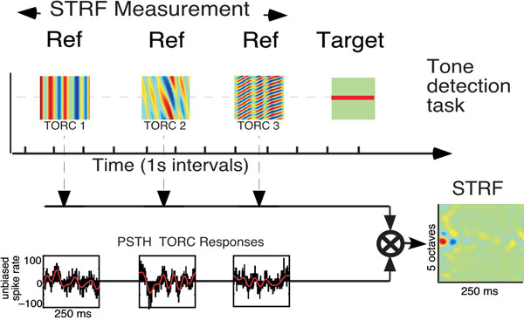
Fritz et al.: Measuring STRFs in a Behaving Ferret
Ferrets drink from water spout while listening to sound stimuli. Broadband “TORCs” signal that the animal can drink in comfort. Pure tones signal that a mild but unpleasant electric voltage is about to be applied to the spout. The animals quickly learn to interrupt drinking until the TORCs resume. The sound frequency of the warning (“target”) tone is held constant throughout an experimental session. A1 STRFs can be constructed by reverse correlation with responses to TORC stimuli.

Slide 59
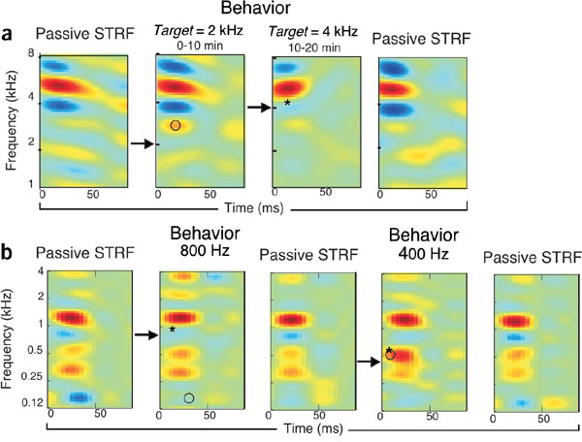
Attention Induced STRF Changes
From Fritz et al Nature Neuroscience 6, 1216 - 1223 (2003)
Filter properties (STRFs) of A1 neurons change rapidly as the animal attends to particular target frequencies.

Slide 60
Attention Has a High Metabolic Cost :-
Experiments by David Heeger and Colleagues

Slide 61

Pattern Detection Task
Stimulus:
Task:
versus
uniform field
threshold contrast pattern
Auditory cue:
present
present
absent
Stimulus:
Response:
yes
no
yes
0
10
20
30
40
Time (s)

Slide 62
Strong response when stimulus is present
Individual trial time series
0.5
average of 296 trials
subject: DBR
0.4
0.3
0.2
fMRI response
(% BOLD signal)
0.1
0
-0.1
mean, std. error
-0.2
0
2
4
6
8
10
12
14
16
Time (s)

Slide 63
Most of the metabolic energy is spent trying to see, rather than seeing.
Base response when stimulus absent — attention?
Small increment when stimulus present — sensory signal?
Stimulus present
0.5
Increment
0.4
0.3
0.2
fMRI response
(% BOLD signal)
Base response
0.1
Stimulus
absent
0
subject: DBR
-0.1
-0.2
0
2
4
6
8
10
12
14
16
Time (s)

Slide 64
Attention
Is mediated by feedback descending pathways from higher order to lower order sensory structures.
Is related to expectations.
Can reduce sensitivity to unattended stimuli and enhance sensitivity to attended ones.
Can require more “effort” (metabolic cost) than mere feed-forward processing of stimuli.

Slide 65
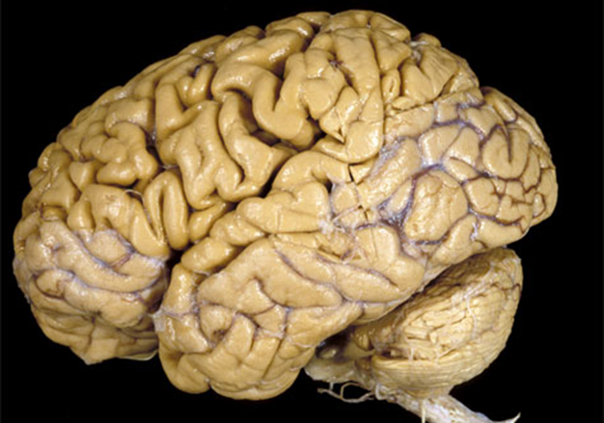

How the Brain Works:
It’s not that complicated really.
Internal State
“Memory”
Motor
Output
CNS
Sensory
Input
“Attention”

Slide 66
We hope you enjoyed the course.
Please send us feedback!
Complete TLQ if you haven’t done so already.

