Slide 1
What Brains are Made Of & What Makes them Electric
How Your Brain Works
Prof. Jan Schnupp
wschnupp@cityu.edu.hk
HowYourBrainWorks.net

Slide 2
A Neuroscient’s Favourite Atoms
There are well over 100 different types of atoms (chemical elements). Luckily, to understand how brains work we need to know only about a few of them, including:
Hydrogen (H)
Oxygen (O)
Carbon (C)
Nitrogen (N)
Phosphorus(P)
Sodium (Na)
Potassium (K)
Calcium (Ca)
Chlorine (Cl)
Magnesium (Mg)

Slide 3
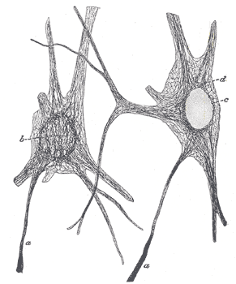
Recipe for Neurons
Ingredients:
Water (H₂O)
Salt (NaCl)
Fat (CH₃C_{N}H_{2N}COOH)
Protein (lots of C and H, some O and N, and a tiny bit of S)

Slide 4
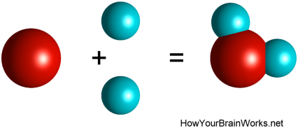
WATER (H₂O)
Neurons are filled with intracellular fluid (cytosol, predominantly water) and are bathed in extracellular fluid (also predominantly water).

Slide 5
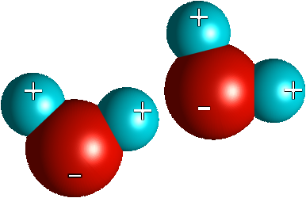
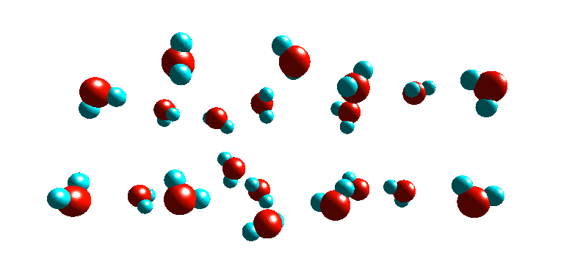
Water is a Polarized Molecule
Water molecules “stick together” due to electrostatic attraction and “hydrogen bonds”

Slide 6
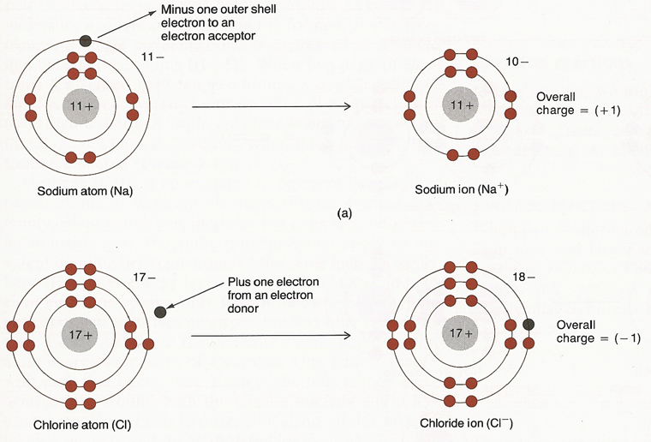
Salts form Ions

Slide 7
Electrostatic Forces
Coulomb’s Law: The electrostatic attraction (repulsion) between two opposite (identical) charges is inversely proportional to the square of the distance between them.
Half the distance → four times the force.
Large distance → very small force.
Zero distance → infinite force.
+
-
+
-

Slide 8
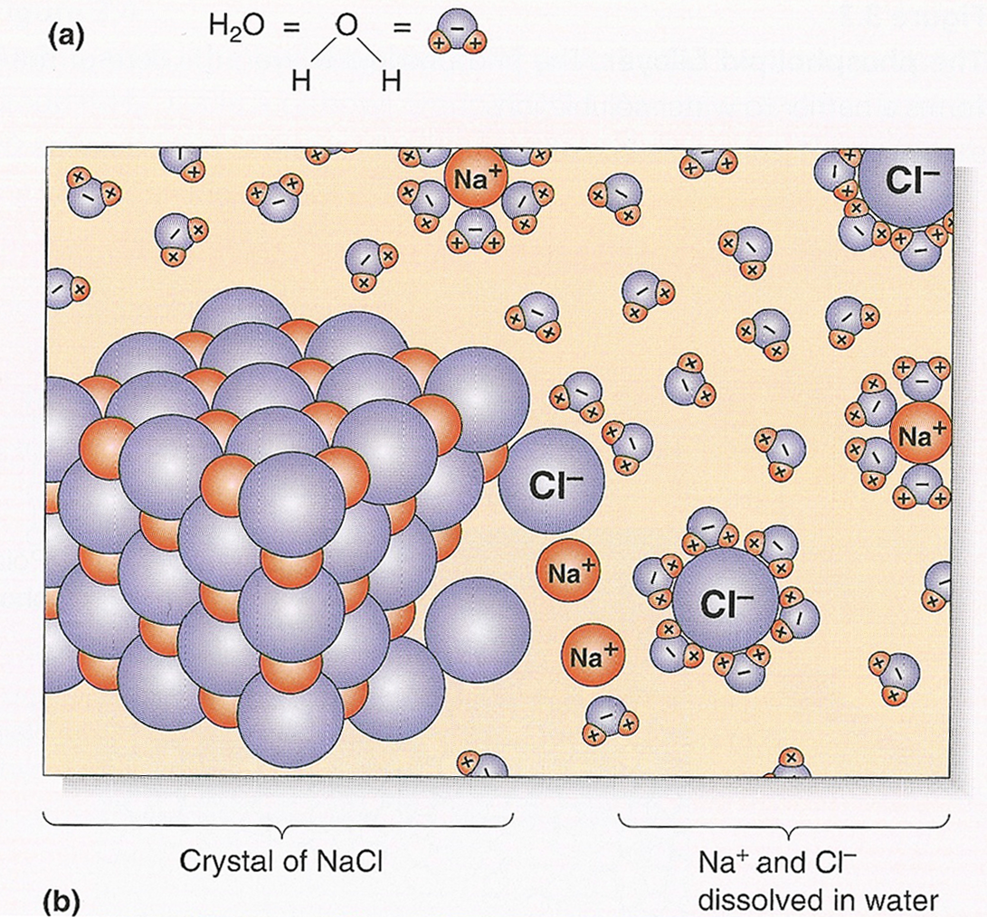
Salt in Solution
When dissolved in water, salts dissociate into electrically charged ions which can move freely in the solution.

Slide 9
Diffusion

Slide 10
Ions of Importance in Neuroscience:
Cations:
Sodium: Na⁺
Potassium: K⁺
Calcium: Ca⁺⁺
Anions:
Chloride: Cl⁻
Organic Anions
In Greek, “ana” is “up” and “kata” is “down”. Cation is “the down-going”, Anion is “the up going”).
If you kind of think of it to be “the normal default” of charges to be positive and to flow “downhill” then you can remember that positive charges will flow “towards the cathode” (“the down path”).

Slide 11
Important take-home message
Nerve cells are both filled with, and surrounded by, “salty water”. Lots of Brownian motion and diffusion are pushing charged ions this way and that. Therefore, there are lots of tiny random electrical currents in all directions all the time.
But on average there is as much chance of a charge being pushed left as of it being pushed right. The average net current is going to be very close to zero pretty much all the time (unless the movement of ions can be “organized” somehow).

Slide 12
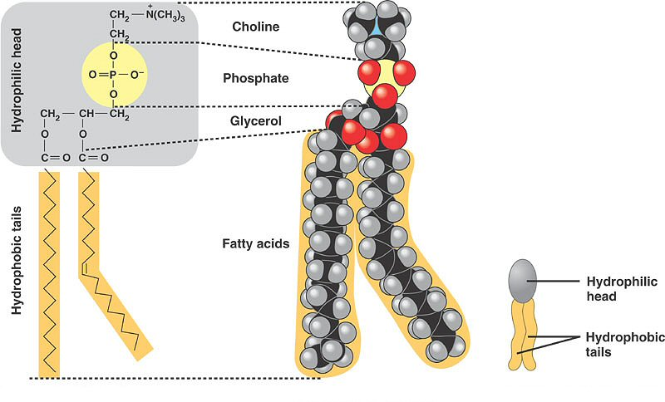
FAT (CH₃-(CH₂)_{N}-COOH)
Cell membranes are made of fat (Phospholipids)
Notes:
https://ehumanbiofield.wikispaces.com/Membrane+and+Cellular+Respiration+HW1+MC

Slide 13
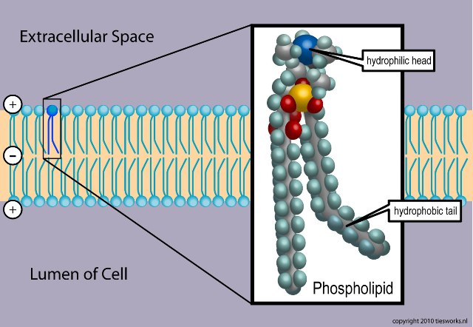
Phospholipid Bilayers
Cell membranes are water-impermeable sheets of phospholipids
Notes:
http://upload.wikimedia.org/wikipedia/commons/3/39/Phospholipid_TvanBrussel.jpg

Slide 14
Cell Membranes and Electrical Currents
The movement of electrically charged ions that are dissolved in water is the basis of electrical currents in and around nerve cells.
The fatty (phospholipid) cell membrane is impermeable to ions. Electric currents therefore can flow along membranes easily, but through membranes only where there are pores (“channels”) in the membrane.

Slide 15
Protein
Hydrophobic | Hydrophilic | Charged
Glycine Alanine Valine Leucine Isoleucine Methionine Phenylalanine Tryptophan Proline | Serine Threonine Cysteine Tyrosine Asparagine Glutamine | Aspartate Glutamate Lysine Arginine Histidine
Proteins are chains of amino acids.
All proteins are made from only 20 different amino acids.
Amino acids come in fat soluble (lipophilic), water soluble (hydrophilic), as well as charged and uncharged varieties.
You don’t have to remember the names of all 20 amino acids but you should have heard of them so you can recognize them.

Slide 16
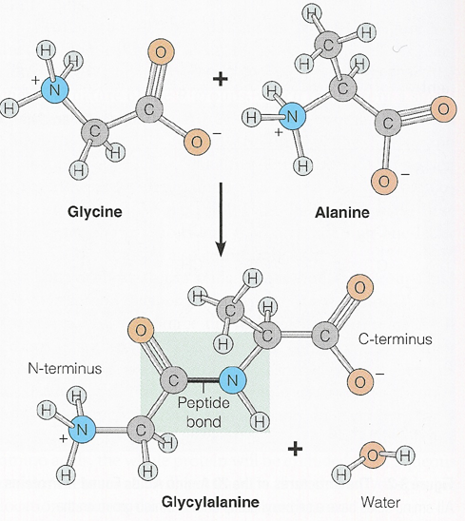
Peptide Bonds
bind amino acids together to form “peptides” (short chains) or proteins (long chains)

Slide 17
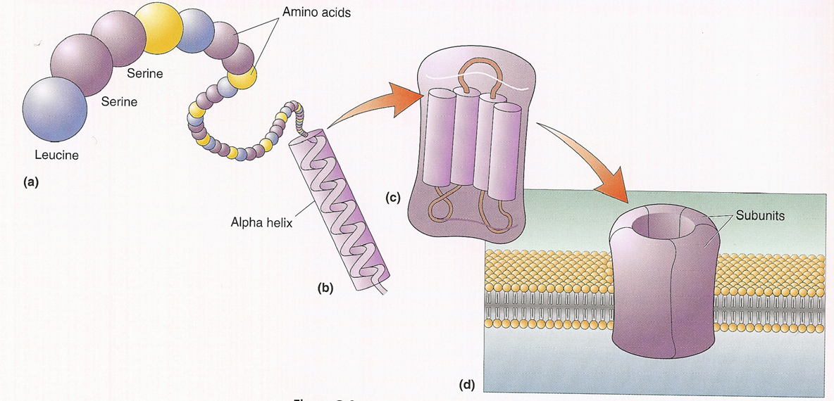
Folding of Protein Chains
Proteins “fold” to form useful building blocks,
like trans-membrane channels, enzymes, or structural proteins

Slide 18
Important Proteins
Enzymes: catalyze (i.e. facilitate) all sorts of biochemical reactions within the cell
Trans-membrane channels: regulate the movement of ions and other substances through the cell membrane
Receptors: sense the presence or absence of certain substances in the fluids outside the cell membrane
Structural proteins: act like scaffolding and determine the cells shape.

Slide 19
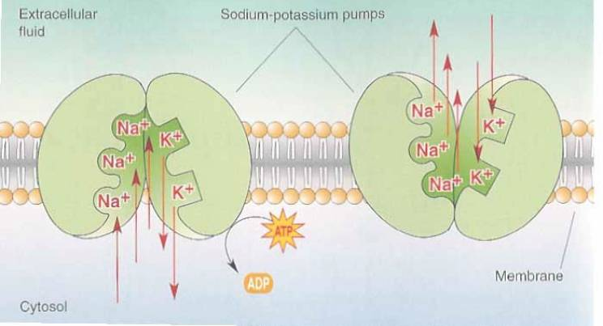
The Sodium-Potassium Pump
The Na/K pump actively transports Na⁺ out of the cell and K⁺ into the cell
It requires energy (provided by ATP)

Slide 20
Other Ion Pumps and Exchangers
The Na⁺/K⁺ pump is only one of several ion pumps
Some ion pumps are powered by concentration gradients, rather than ATP hydrolysis. These are called ion exchangers. Examples are shown here:
Na⁺ - Ca⁺⁺
exchanger
Bicarbonate - Cl⁻
exchanger
outside
HCO₃⁻
Na⁺
Na⁺
Ca⁺⁺
Cl⁻
inside

Slide 21
Ionic Concentrations
Ion
Conc. In (mM)
Conc. Out (mM)
Na
+
18
150
Cl
-
7
120
Ca
++
0.00001
1.2
K+
135
5
organic anions
74
13
Approximate intracellular and extracellular concentrations of a number of important ion species for a “typical mammalian neuron”. (You don’t have to remember the exact values)

Slide 22
Remember This!
Na⁺ and Cl⁻ concentrations are higher outside the neuron than inside.
K⁺ and A⁻ concentration are higher inside than outside.
Neurons keep intracellular Ca⁺⁺ concentrations very low.
Neurons are in electrochemical equilibrium

Slide 23
Resting Membrane Potentials
All cells (not just neurons) display an electrical potential across their cell membranes.
At rest, neurons display a ‘resting membrane potential’ of around -70 mV.
Given that the membrane is only 10 nanometers (billionths of a meter) thick, the electric field strength in the membrane is ca 7 million volts / meter !

Slide 24
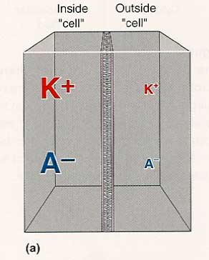
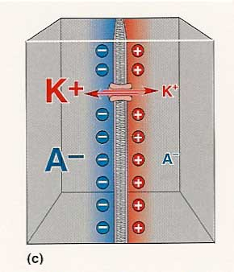
Electrochemical Equilibrium
Ions diffuse through selective channels in a membrane.
Their partners of opposite charge are left behind.
An electrical gradient is set up across the membrane.
Further diffusion is opposed by the electrical gradient.

Slide 25
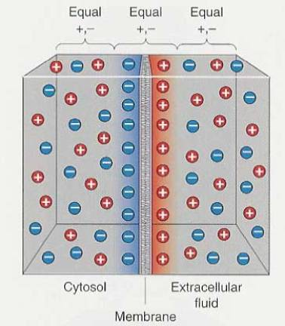
Gradients, Concentrations and Charge
Electrostatic forces are strong.
Hence, a redistribution of a modest number of ions can give rise to sizeable potentials (voltages).
The amount of charge (number of ions) that needs to be moved to set up a particular voltage depends on the membrane capacitance. C=Q/V => V=Q/C.
Electrochemical equilibrium is reached after only tiny changes in relative ion concentrations.

Slide 26
The Nernst Equation
Predicts “equilibrium potential” (i.e. voltage large enough to stop net charge movement by diffusion)
E : Voltage (mV)
R : Gas Constant
T : Temperature (°K)
F : Faraday’s Constant
z : Number of Elementary Charges on each Ion
C_{in}, C_{out}, []_{in}, []_{out} : Concentrations inside or outside the cell (mM)

Slide 27
The Goldman Equation
An extension of the Nernst Equation, which considers several Ion species, and “weights” the contribution of each ion by it’s respective permeability (P) (Note: whether the internal concentration appears in the numerator or the denominator depends on the sign of the charge of the ion)

Slide 28
Important take-home message
Nerve cells are said to be in “electro-chemical equilibrium”: electrostatic forces may push charged ions one way, diffusion down a concentration gradient may push them the other way.
The voltage at which there is no net charge movement is called the equilibrium potential. It can be calculated with the Nernst (or Goldman) equation. (You will not be expected to remember these equations or to apply them for this course, but you should have heard of them).

Slide 29
Let’s take a short break

Slide 30
From Resting Potentials to Electrical Signals
In addition to the resting (K+ leakage) channels, neurons can have a large variety of gated ion channels which will open transiently in the presence of certain stimuli or chemical signals. These gated channels may be permeable to Na+, Cl- or Ca++.
When these gated channels open, the voltage across the membrane will change to reflect the new permeabilities as predicted by the Goldman equation.
The presence of physical or chemical signals which are capable of opening the gated channels is thus “encoded” as a change in membrane potential.

Slide 31
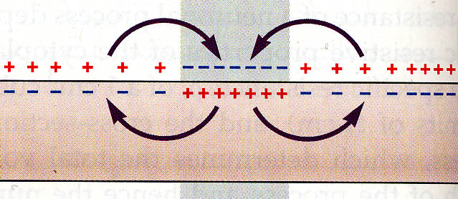
Passive Propagation of Electrical Signals
Ions flow easily along, but not across membrane. (Membrane resistance is much higher, than that of intracellular and extracellular fluid).
To change the potential on a distant patch of membrane, enough current has to flow to discharge the membrane capacitance at that point.

Slide 32
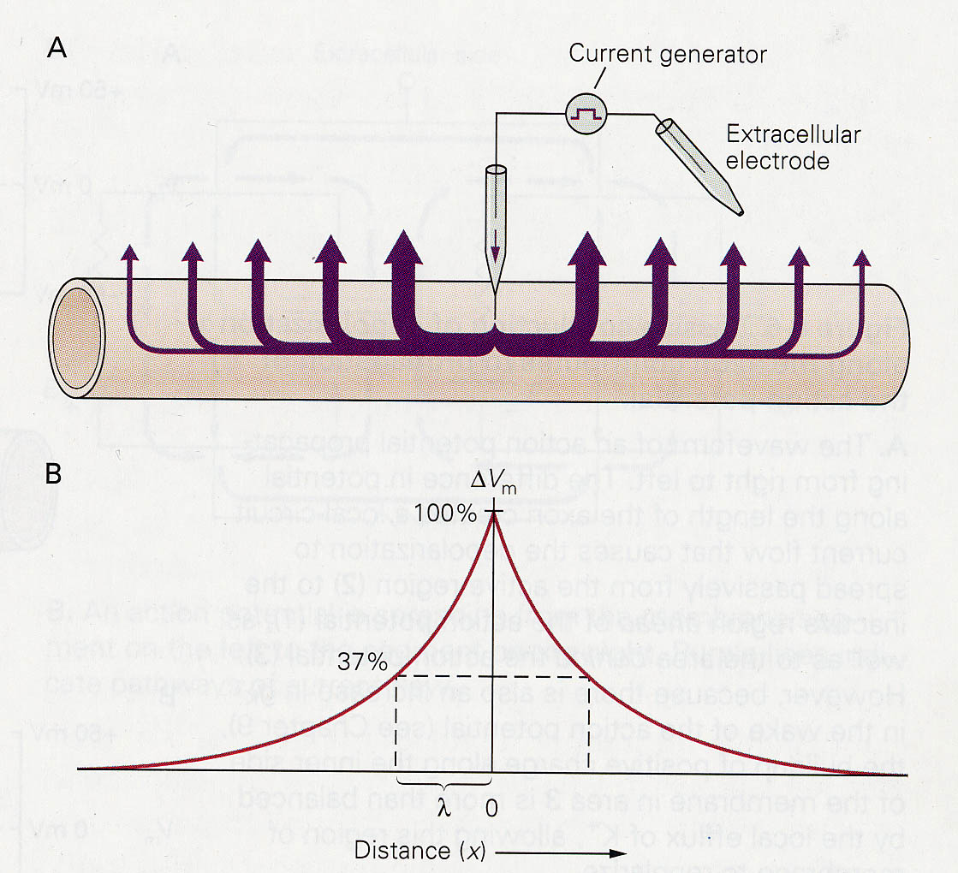
Limitations of Passive, Graded Signals
Some of the current does leak through the membrane.
Consequently passively conducted signals decay after relatively short distances (small space constant).

Slide 33
Leakage
A-
A-
A-
Na+
Na+
K+
K+
K+
A-
A-
A-
K+
K+
K+

Slide 34
Capacitative Leakage
Na+
A-
A-
A-
K+
K+
K+

Slide 35
The Voltage Gated Na+ Channel
Normally closed when the membrane is at rest. Opens briefly (ca 0.5 ms) when the membrane depolarises to a certain threshold.
Once open, rapidly closes again and remains inactivated (“refractory”) for another 0.5 ms or so.

Slide 36
Action Potentials as Positive Feedback Processes
Depolarisation to threshold opens a few Na⁺ channels, which allows further Na⁺ influx, causing further depolarisation, which spreads passively down the axon allowing further Na⁺ channels to open.
This positive feedback process continues until all voltage gated Na⁺ channels in the local patch of membrane have been through the open state and are inactivated (refractory).

Slide 37
Consequences of Positive Feedback
Advantage: the feedback current injection allows action potentials to travel along axons for considerable distances without loss of signal. (Fresh Na+ currents make up for leakage).
Disadvantage: action potentials are “all or nothing”. They cannot transmit information by their amplitude, so graded voltage signals are no longer possible. Hence “spike codes” have to employ other coding strategies, relying purely on the rate or timing of action potentials.

Slide 38
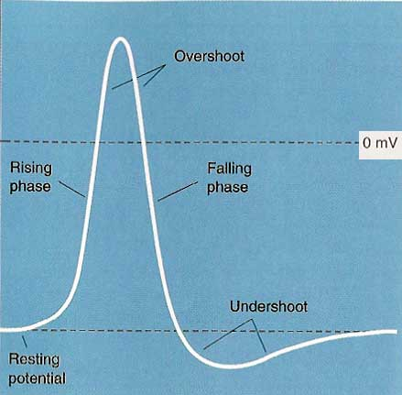
The Shape of Action Potentials
The first published intracellular recording of an action potential, recorded by Hodgkin and Huxley in the giant axon of the squid.
Note the overshoot: the peak of the action potential is positive. (E_{Na} is positive).
The recording shows several other phases:
The stable resting potential
A rapid rising phase
A rapid falling phase
A prolonged undershoot
1 ms

Slide 39
After-hyperpolarisation (or “Undershoot”)
In addition to Na⁺ channels, many axons also contain voltage gated K⁺ (“rapid rectifier”) channels.
K⁺ rectifier channels are slower than Na⁺ channels. They take longer to open, and stay open for longer.
Their role is to speed up the re-polarisation of the membrane following the Na⁺ action potential.

Slide 40
How Do We Know All This?
Nobel Prize 1963
Pioneering experiments by Hodgkin & Huxley were performed on giant axons of squid.
These axons are large enough to allow axoplasm to be replaced by fluids of known ionic composition.
Axon
Roller
Cannula

Slide 41
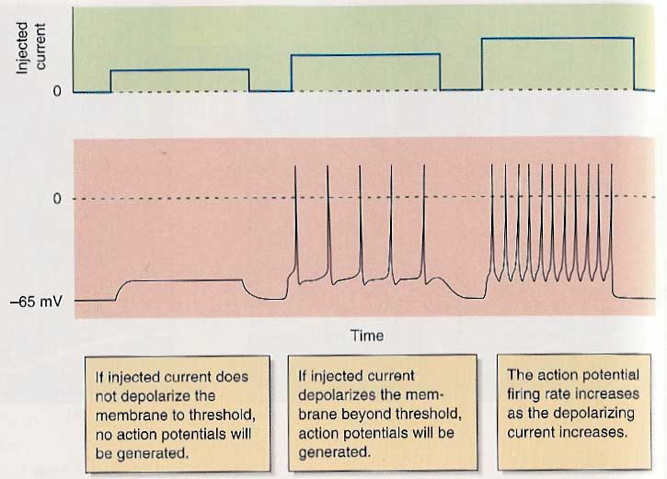
Another Look at AP Initiation: The Neuronal Threshold

Slide 42
Neurons “encode” injected currents as firing rates
Small, sub-threshold currents injected into a nerve cell don’t do anything, they just leak out again.
Larger currents will trigger action potentials. The stronger the currents, the faster the action potential rate. => “Rate Coding”
Reflect on why this is so. If you don’t understand this important principle, ask in the tutorials.

Slide 43
Action Potentials as a “Digital” Code
An axon connected to a muscle stretch receptor signals the degree of stretch by the temporal pattern of action potentials
Changes in stretch cause a change in the rate of action potentials.
All the action potentials are roughly of the same height
The action potentials are brief (ca 1 ms).

Slide 44
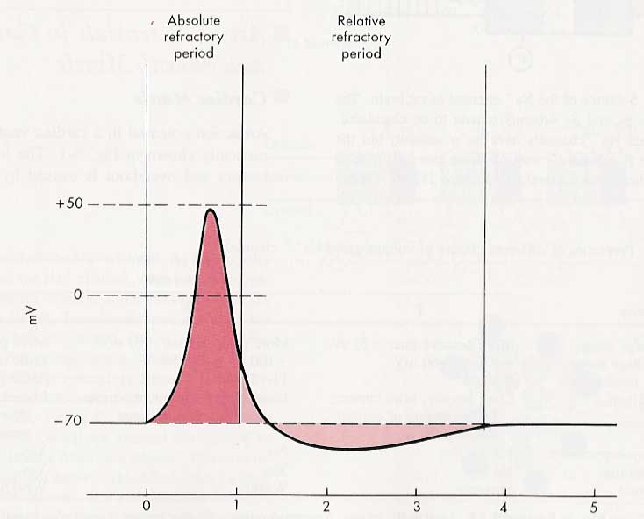
Refractory Period
For a time after an action potential (AP), the probability of generating a second AP changes.
During the absolute refractory period no action potentials can be generated, because Na+ channels are deactivated.

Slide 45
Refractory Periods and Firing Rates
The absolute refractory period lasts ca 1 ms.
Therefore, no neuron can fire at firing rates faster than ca 1000 Hz.
Most neurons show some degree of adaptation, and rarely do neurons sustain firing rates of a few hundred Hz for any length of time.

Slide 46
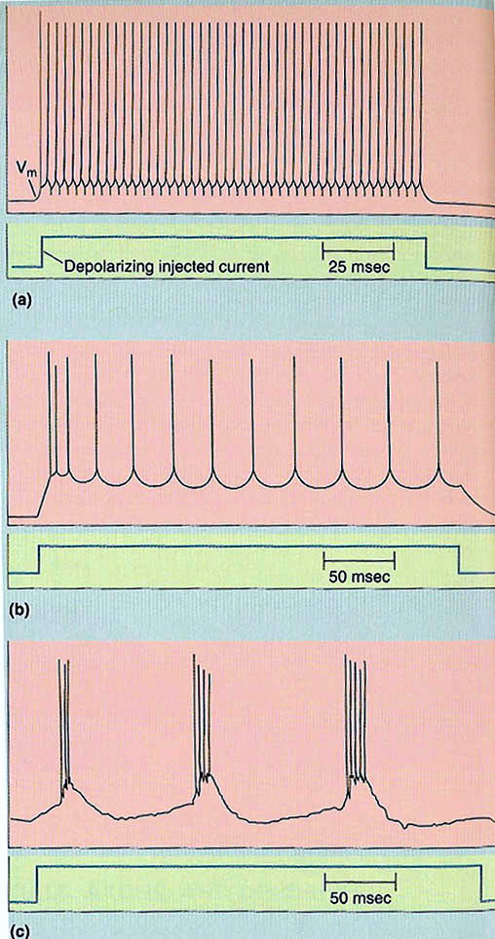
Firing Modes
Regular firing in response to a steady state current input is the exception in the brain.
Most neurons show adaptation (decrease in firing rate). Some neurons fire bursts.
Some neurons may even change from regular to burst mode or vice versa depending on the animal’s state of arousal or attention.
Firing modes are due to the effect of other voltage gated channels.

Slide 47
Note that “rate coding” may be complicated
Effects such as “refractory periods”, “adaptation”, and “active processes” such as bursting mean that the relationship between input current and output firing rate can differ from a simple, “linear” proportionality.

Slide 48
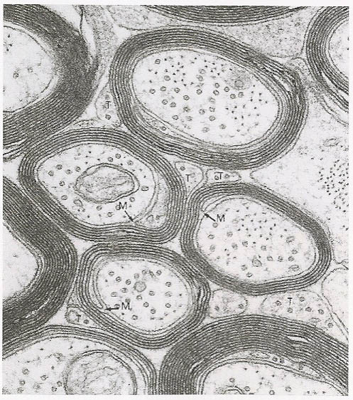
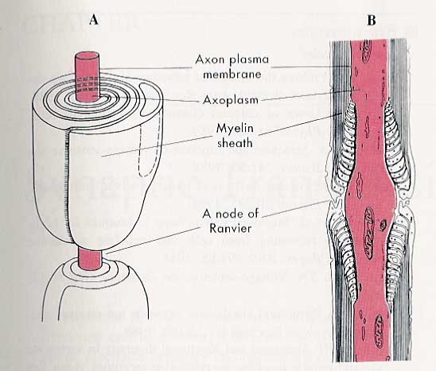
The Myelin Sheath
Myelin sheathes are specialised extensions of the cell membranes of certain glial cells (Schwann cells and oligodendrocytes), which tightly wrap around axons.

Slide 49
Demyelinating Diseases
In certain diseases, such as Multiple Sclerosis, the myelin sheath around axons becomes degraded.
This will initially reduce conduction velocity, but as the disease progresses, action potential conduction will not only be slowed, but becomes unreliable and finally fails completely.
This causes very serious problems, ranging from blurred vision and numbness to muscle weakness or even severe paralysis.

Slide 50
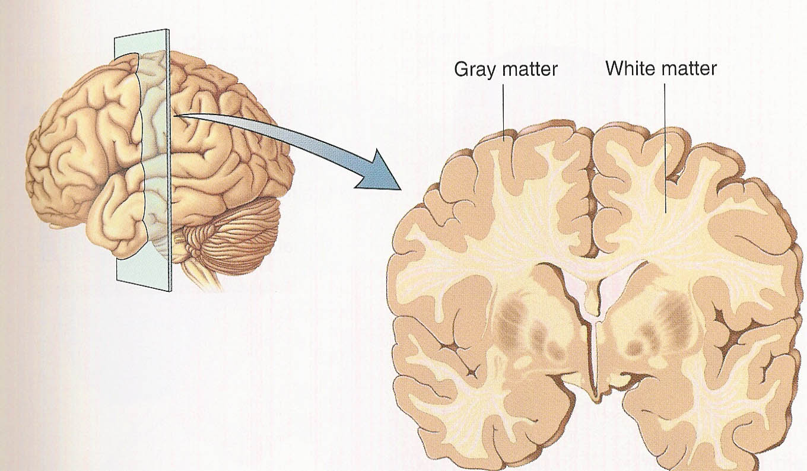
Myelin “Factoids”
Gray matter
White matter
The brain’s “white matter” is white because of the high myelin content.
The myelination of axons in the brain of human infants is not complete at birth (which partly explains their neurological immaturity).
Myelin is an invention of vertebrate nervous systems (which is why even little squid need giant axons).

Slide 51
Summary
Moving ions from dissolved salts carry electrical currents in neurons.
Differences in ion concentrations between inside and outside of neurons can create voltages across the cell membrane. (“equilibrium potential”)
Opening or closing chemically or mechanically gated ion channels in cell membranes changes the permeability which in turn changes the membrane voltage. This can encode information.
Current leakage means that neurons cannot conduct electrical signals passively over distances greater than 1mm or so max.
To send signals along potentially very long axons, nerve cells use action potentials (“nerve impulses”) which propagate through the help of voltage gated ion channels.
Myelin sheaths on axons make action potential propagation faster and more reliable.

