Slide 1

A First Encounter:
Fundamentals of Brain Structure and Function
How Your Brain Works - Week 1
Prof. Jan Schnupp
wschnupp@cityu.edu.hk
http://HowYourBrainWorks.net

Slide 2
Course Objective
You are your brain.
Every sight you ever see, every thought you ever think, every desire you ever feel, every dream you ever dream, all your decisions and movements are just manifestations of brain activity.
They should be understandable and explainable in terms of brain organisation (anatomy) and function (physiology).
In this course we aim to give you a sense of the science that underpins these remarkable claims.

Slide 3
Course Outline
See the Course Schedule http://howyourbrainworks.net/timetable
There will be lectures and tutorials as indicated on the timetable.
About every other tutorial we conduct a graded multiple choice QUIZ to test your knowledge and understanding of the preceding lectures. There are 5 quizzes on the dates given in the timetable.
The mean of your best 4 quiz scores will be your continuous assessment grade, which counts for 50% of your final grade. So make sure you attend quizzes, revise your lecture notes before each tutorial and don’t hesitate to ask the relevant TA (listed in course schedule) for advice.

Slide 4
Dos and Don’ts
DO ask questions!
DO ask questions in the breaks during lectures!
DO ask questions in the tutorials!
DO send questions to the TAs by email!
DON’T just sit there if you don’t understand something. Ask questions!

Slide 5
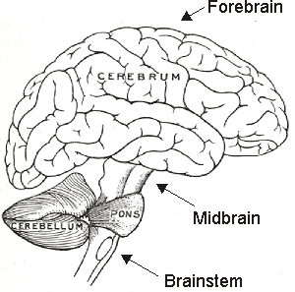
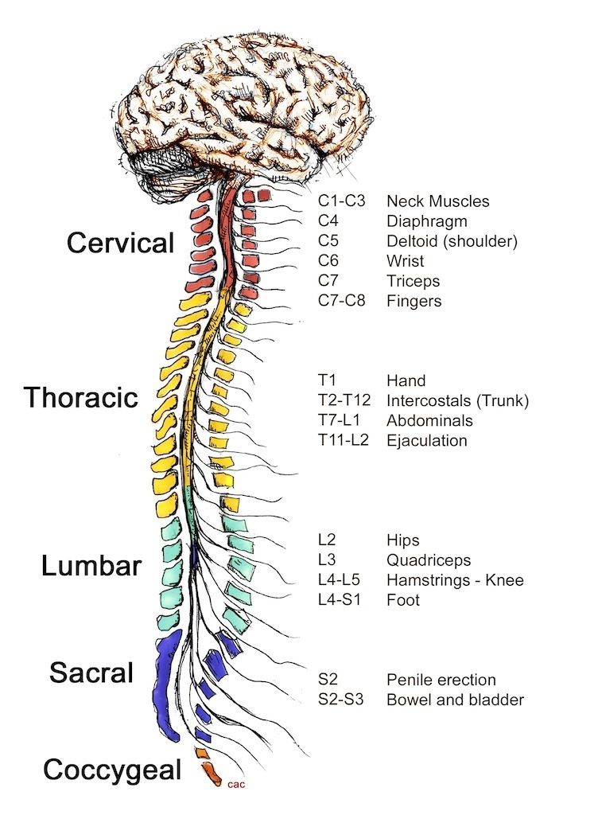
A First Encounter
All your thoughts, dreams, memories, perceptions and emotions are the product of your brain.
The brain together with the spinal cord and the cranial nerves form the central nervous system (CNS) which also controls numerous conscious and unconscious functions of your body.
Notes:
Image source Gray’s anatomy Fig 677

Slide 6
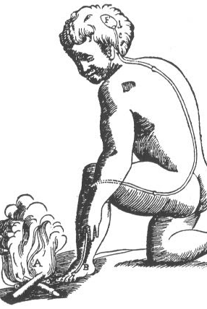
The Oldest Brian Functions: “Reflexes”
In 1664, Rene Descartes correctly hypothesized in “Treatise of Man” that nerves are conductors of information from the skin and sense organs to the brain and back from the brain to the muscles.
The central nervous system evolved as a device made of nerve cells that processes information to convert sensory input into appropriate motor output.
Notes:
Image source Gray’s anatomy Fig 677

Slide 7
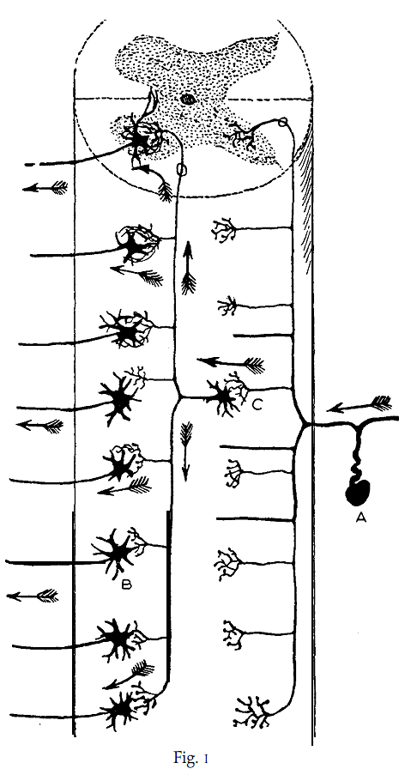
Spinal Chord
The oldest part of the central nervous system, takes in information from sensory neurons at the back (the “dorsal nerve roots”), and sends information back out through nerves at the front (the “ventral roots”).

Slide 8
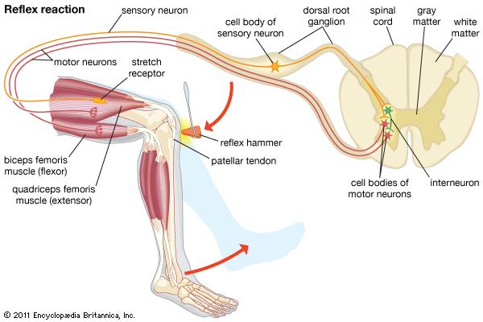
A Simple Reflex Arc (Patellar Reflex)
A sudden tap on the patellar tendon stretches the quadriceps muscle.
This activates sensory stretch receptor neurons (“dorsal root ganglion cells”) which connect to motor neurons in the ventral horn of the spinal cord. The motor neurons cause the quadriceps muscle to contract.
At the same time inhibitory interneurons in the ventral horn cause motor neurons which innervate the hamstrings to relax.
Notes:
Image source Gray’s anatomy Fig 677

Slide 9
Reflex Arcs
The patellar reflex is an incredibly simple neural circuit (“monosynaptic”) which helps with postural adjustment (resist a sudden bending of the knee).
There are many more complex reflexes (e.g. withdrawal reflexes) and neural control structures (e.g. central pattern generators which produce rhythmic locomotive movement) that “are bolted on top” of these simple reflexes.
Note that in this reflex, sensory information enters the central nervous system at the back, and motor outputs are computed and sent out of the front. This is a general pattern of organization that is also true to an extent in higher parts of the brain.
Nerve cells which carry information toward higher processing centres are called afferents. Nerve cells that which carry signals toward motor output structures are called efferents.
Notes:
Image source Gray’s anatomy Fig 677

Slide 10
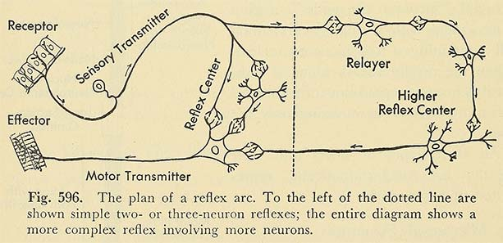
Loops upon Loops
It is useful to imagine the brain as having evolved by layering more and more complex input-output loops on top of existing ones.
Charles Sherrington (Nobel Prize wining Physiologist of the early 1900s) imagined that all brain function might be explainable in terms of potentially hugely complex, interlinked and hierarchically organized reflex arcs that interact.
More recently, brain researchers feel that Sherrington’s view underestimates the importance of innate drives as well as long term memories in shaping perception and motivation (“cognitive” neuroscience)
Notes:
Image source Gray’s anatomy Fig 677

Slide 11
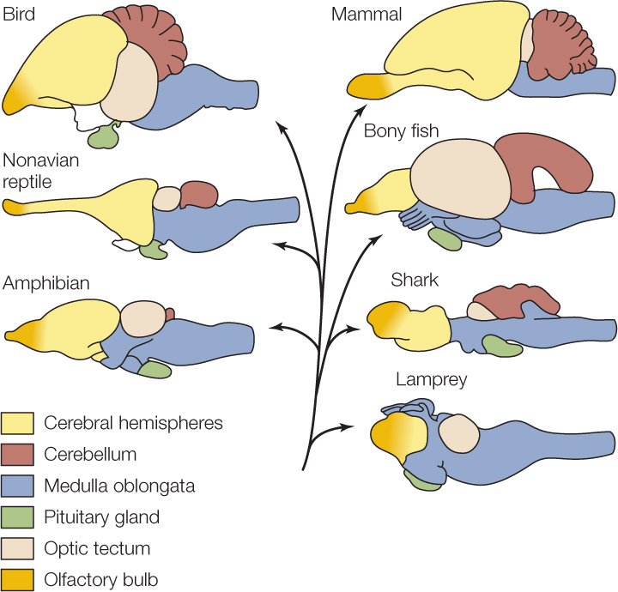
Brain Evolution
Over 100s of millions of years, more and more circuits are added to the brain and expand.

Slide 12
Take-home Message
The central nervous system comprises a hierarchy of circuits which evolved gradually.
Some circuits are more primitive than others, and there may be multiple circuits for any one role.
For example, the older superior colliculus (aka optic tectum) and the newer visual cortex both help to make you see. And ancient spinal chord reflex arcs as well as cerebellar and motor cortical circuits all make you move.
They are all active in parallel. It is perhaps surprising that we can ever be “of one mind” about anything given that the mind is the result of such massively parallel distributed processing.

Slide 13
Neurons
The brain’s circuits are made of nerve cells or neurons. A human brain contains in the order of 100 billion of them.
Neurons differ greatly in shape and size, but on average their cell bodies are roughly about 20 microns across.
Let’s take a closer look.

Slide 14
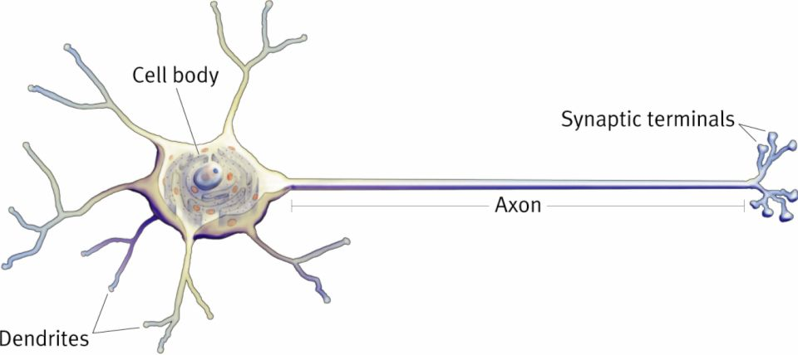
A “typical” neuron
Most neurons, or nerve cells, have long axons that serve as their “output cable” through which they transmit information.
Signals are transmitted along axons using electrical signals.
At the end of axons, synapses serve to use chemical signals to transmit the information on to another neuron (or to a muscle fibre or gland).
Many neurons also have dendrites which receive chemical signals from many (often several thousand!) other neurons and serve as “input cables”.
Notes:
Image source Gray’s anatomy Fig 677

Slide 15
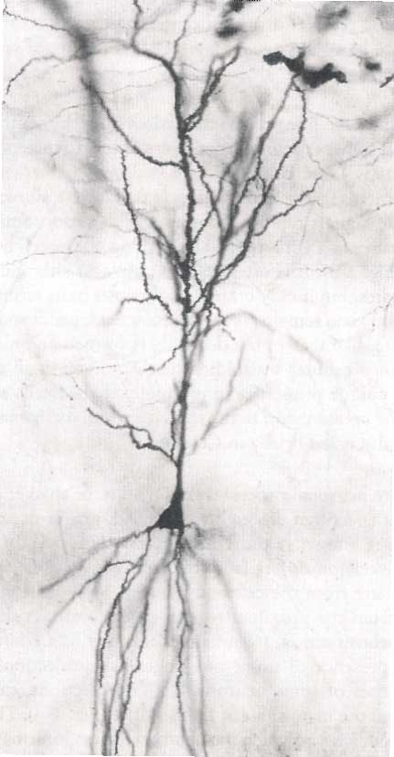
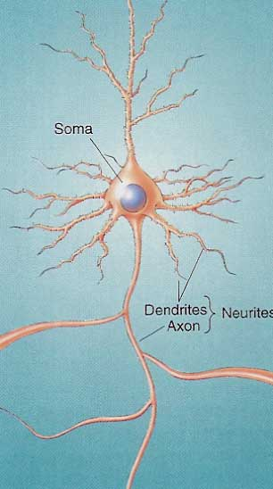
Neurons as Signal
Processing Devices
The Golgi stain reveals different cellular sub-divisions in neurons
Dendrites are the main “input cables”
The cell body, or soma, contains the nucleus. Proteins are synthesized in the soma.
There is typically only one “output cable”, the axon.
Axons can project over relatively long distances (up to several meters)
Dendrites
Soma
Axon

Slide 16
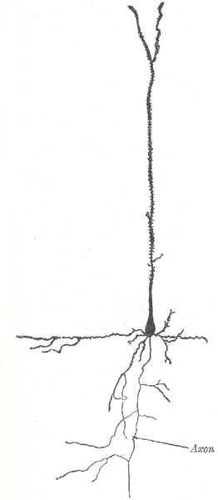
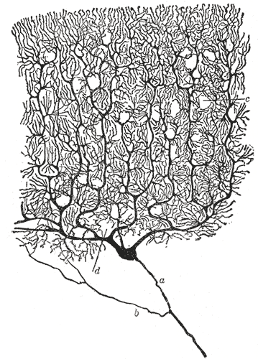
Cortical Pyramidal Neuron
Cerebellar Purkinje Neuron
Dendrites
Somata
Axons
Neurons tend to have several “dendrites” (input cables) but only one “axon” (output cable) each.
A neuron’s cell body is called it’s “soma”. (Plural “somata”)
Notes:
Gray 627 and 628

Slide 17
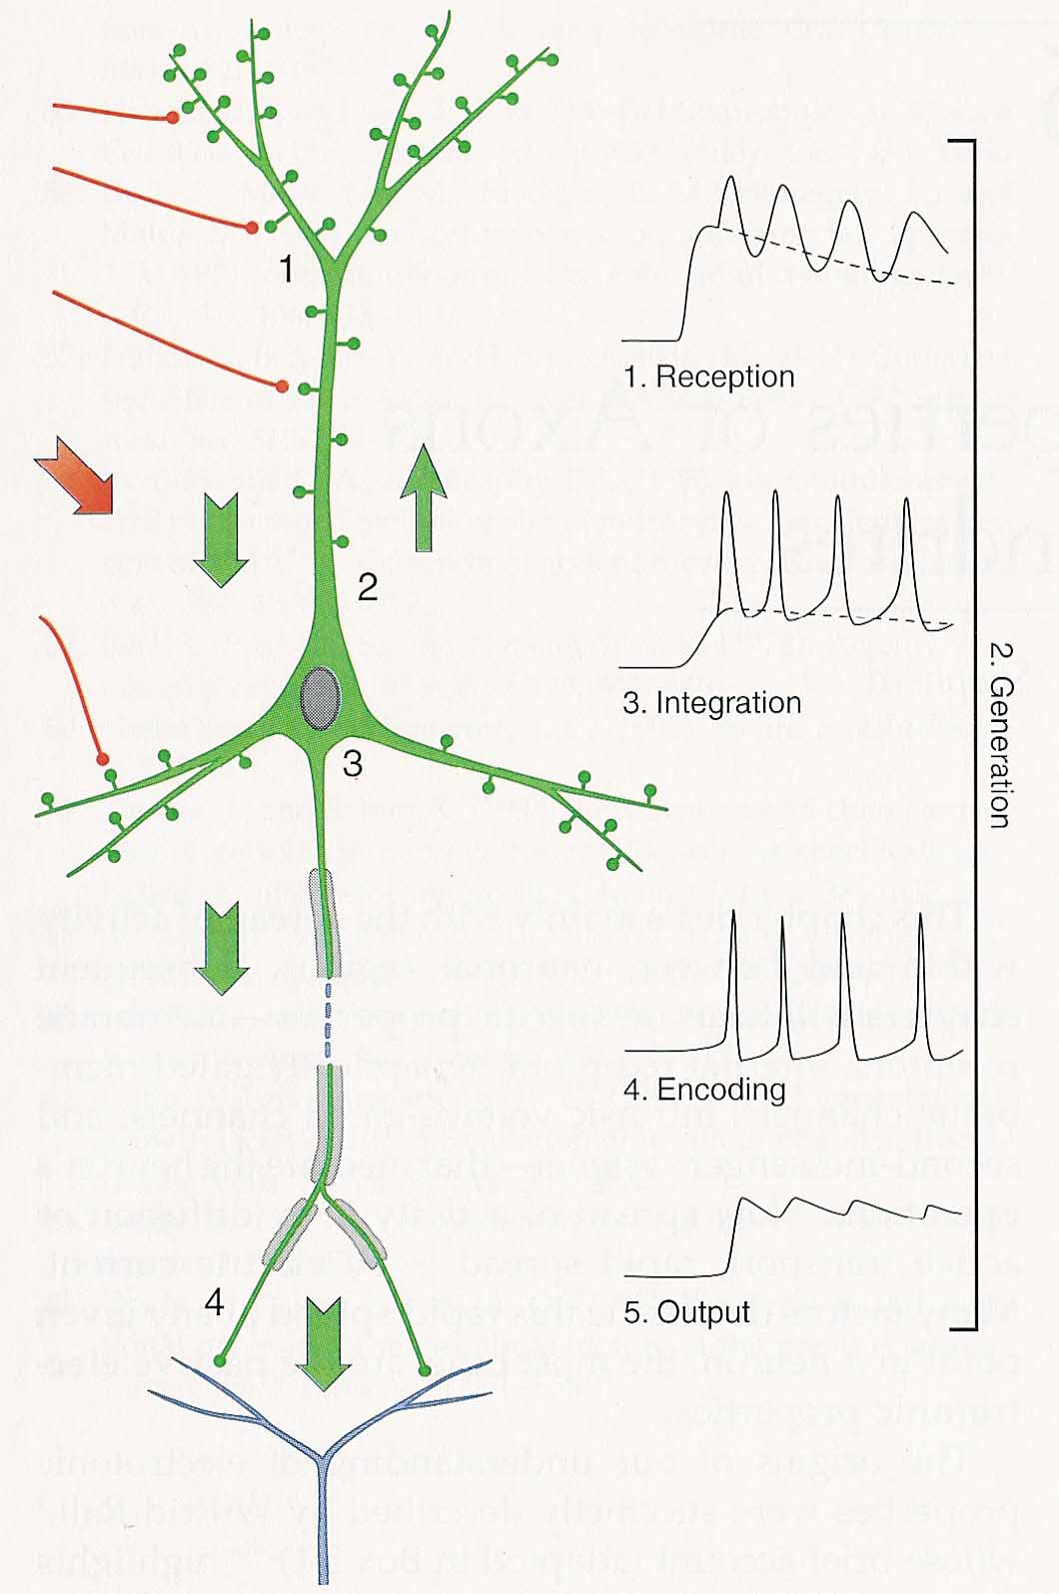
Communication
Between Neurons
The axon of one neuron typically contacts the dendrites or somata of many others
The connections between axons and dendrites are known as synapses.
Synapses are chemical switches: neurotransmitters control the opening of ion channels, allowing electrical currents to flow into or out of the receiving cell.
(More about that in later lectures)
Synaptic currents from as many as 10,000 synapses are integrated (i.e. combined) to determine the voltage at the axon hillock
The voltage at the axon hillock determines the rate of “nerve impulses” (action potentials) sent down the axon to other neurons.

Slide 18
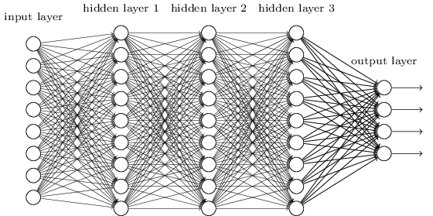
Neural Networks as Computing Devices
The widely convergent inputs (many synapses on many dendrites) and divergent outputs (many axon branches) of neurons mean that neurons form densely connected networks.
The synapses between neurons can be “plastic”, meaning that the connection strength can change. This allows the neural network to learn new “associations” between the pieces of information represented by the activity of individual neurons.
Artificial neural networks (ANNs) are inspired by brain research and led to breakthroughs in artificial intelligence, such as machine translation, “go” world championship, self driving cars etc…
Notes:
Image source Gray’s anatomy Fig 677

Slide 19
Your brain in numbers
You have about 100 billion neurons in your brain. (You also have millions more neurons in your spinal cord, and even in your gut)
Each neuron on average receives and sends out thousands of synaptic connections.
The number of synapses in your brain (~10¹⁵) is therefore tens of thousands of times larger than the number of seconds that you can expect to live (~3×10⁹).

Slide 20
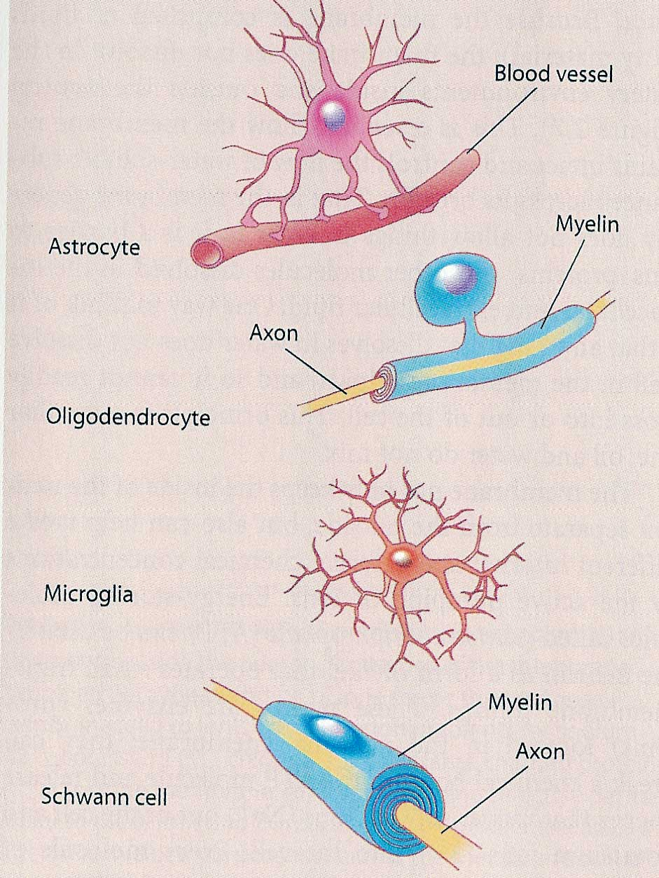
Neurons Are Not the Only Cell Type in the Nervous System
In fact, there are a lot more glial cells then neurons in the nervous system.
They are not thought to carry sensory or motor signals themselves.
There is a diversity of glial cells:
Astrocytes important for the metabolic regulation of the nervous system,
Oligodendrocytes & Schwann cells provide the myelin sheath surrounding axons,
Microglia are involved in immunological reactions to damage in the nervous system.

Slide 21
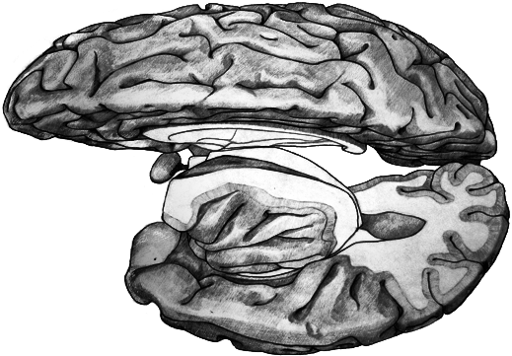
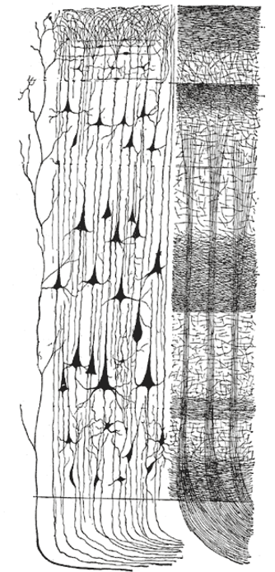
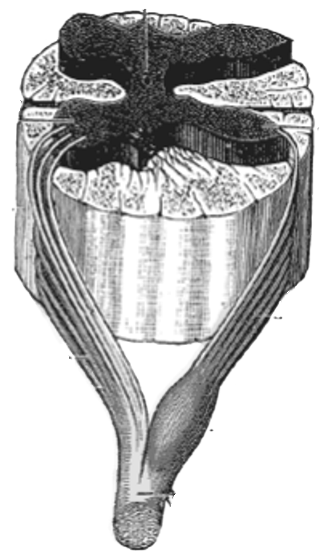
“White Matter” and “Gray Matter”
Brain
Spinal Cord
Gray matter
White matter
Gray matter contains many nerve cell bodies (neurons)
White matter contains mostly nerve fibers (axons)
Notes:
Gray’s figure 675, Jo’s brain, Cajal’s spinal cord, Gray’s 754

Slide 22
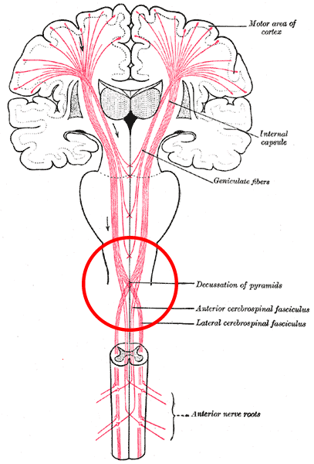
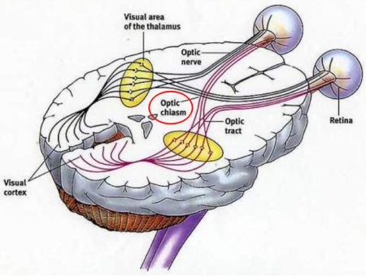
Decussations
Curiously, many of the input and output pathways to and from the brain are “crossed”, so that the left brain hemisphere predominantly processes information from and for the right side of the body and vice-versa.
Crossing points of nerve tracts responsible for this are called “decussations”. Prominent examples include the optic chiasm, or the “decussation of the pyramids” in the cortico-spinal tract.
Notes:
Image source Gray’s anatomy Fig 677

Slide 23
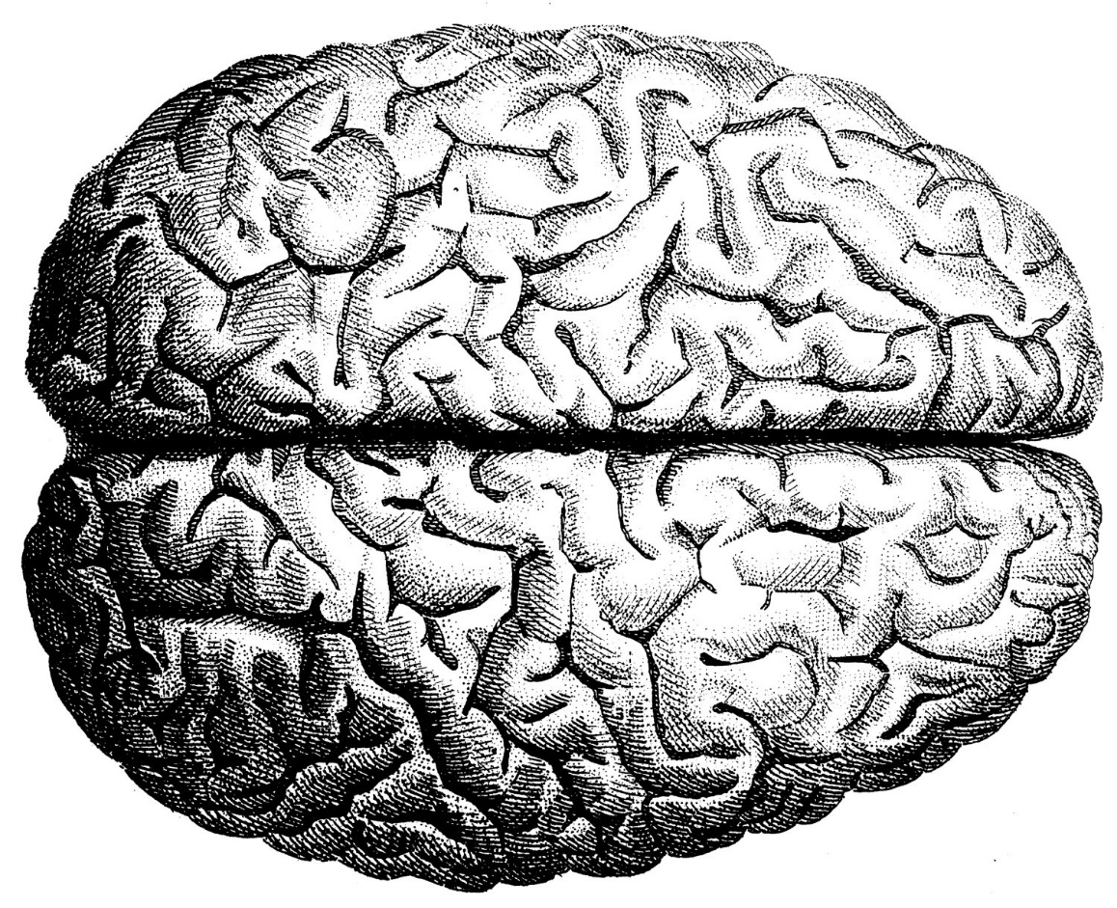
Brain Hemispheres
Much like other systems of the body (skeleton, lungs, sensory organs) the brain is (approximately) mirror symmetric about the midline (the “mid-sagital plane”, as anatomists would say).
Notes:
Image source Gray’s anatomy Fig 677

Slide 24
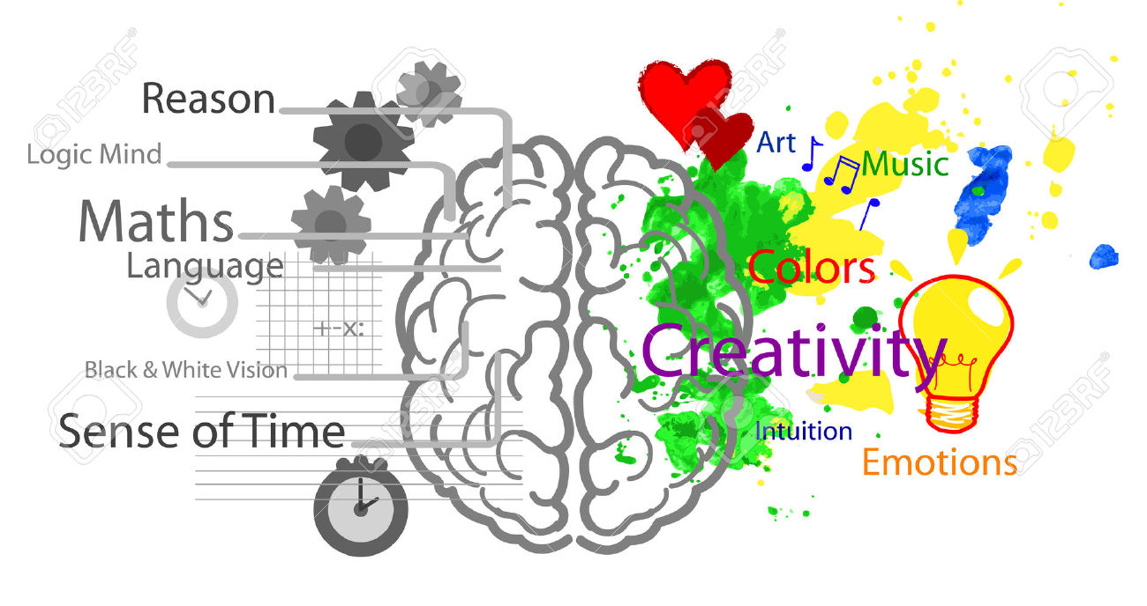
Beware of Brain Hemisphere Myths
While there some hemispheric specialisations (most prominently, the left brain is usually much more involved in language processing), many popular notions of “left brain vs right brain” faculties are oversimplified to the point of being just plain wrong.
Notes:
Image source Gray’s anatomy Fig 677

Slide 25
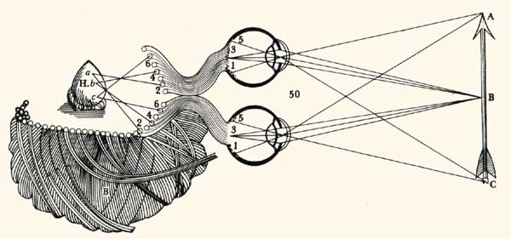
The Pineal Gland is not the Seat Of the Soul
Rene Descartes found the brain hemispheres odd. How can I have only one unified conscious awareness in a brain that appears to be split into two hemispheres?
He therefore suggested that consciousness should reside in the one part of the brain he could find that had no discernible midline symmetry: the pineal gland.
A clever idea, but he was wrong. We now know that the pineal secretes hormones, including melatonin, which makes you sleepy at night.
Notes:
Image source Gray’s anatomy Fig 677

Slide 26
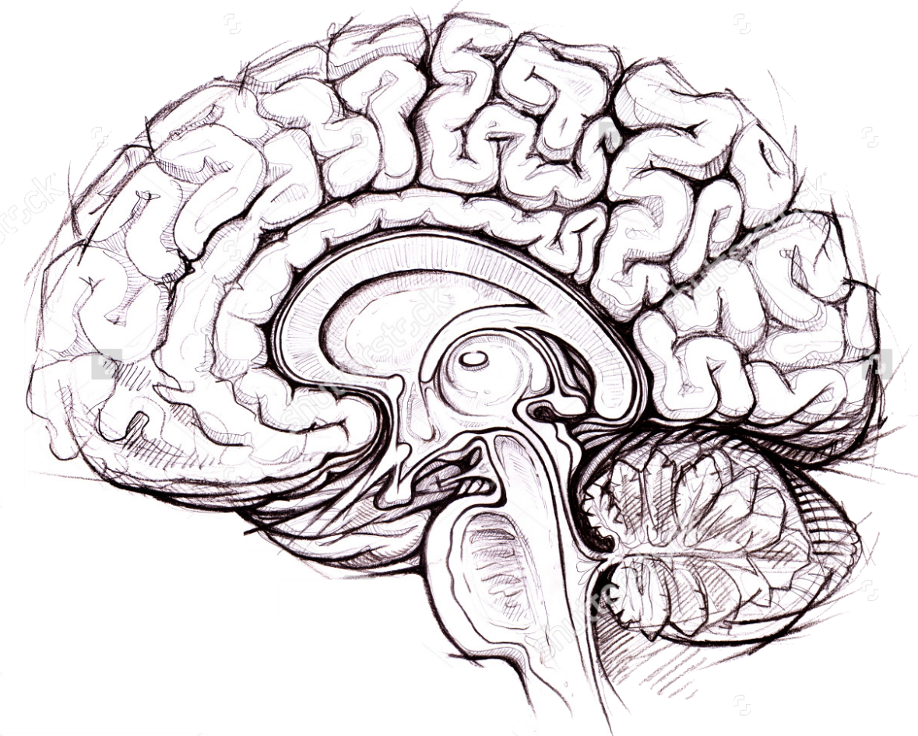
Commissures
Corpus Callosum
There are many nerve fibre bundles providing effective communication between the two hemispheres of the brain.
Fibre bundles connecting one brain hemisphere to the other are called “commissures”. The most prominent commissure is the corpus callosum which connects the two hemispheres of the cerebral cortex.
Notes:
Image source Gray’s anatomy Fig 677

Slide 27

Let’s take a short break

Slide 28
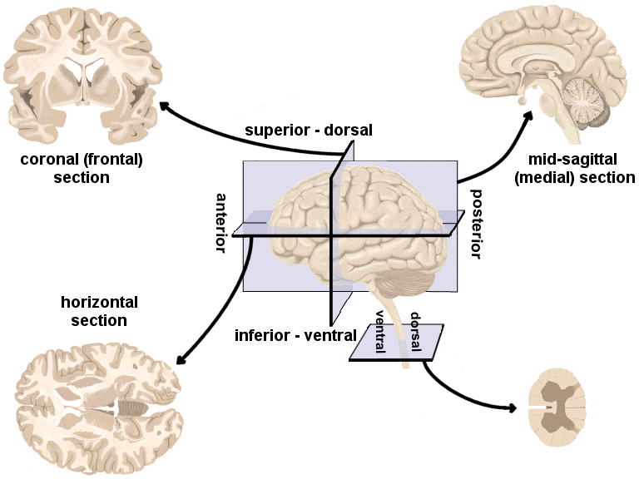
Anatomical Directions
Rostral | Toward face |  | Medial | Toward midline
Caudal | Toward the tail |  | Lateral | Toward the side
Ventral | Toward the belly |  | Inferior | Lower, below
Dorsal | Toward the back |  | Superior | Higher, above

Slide 29
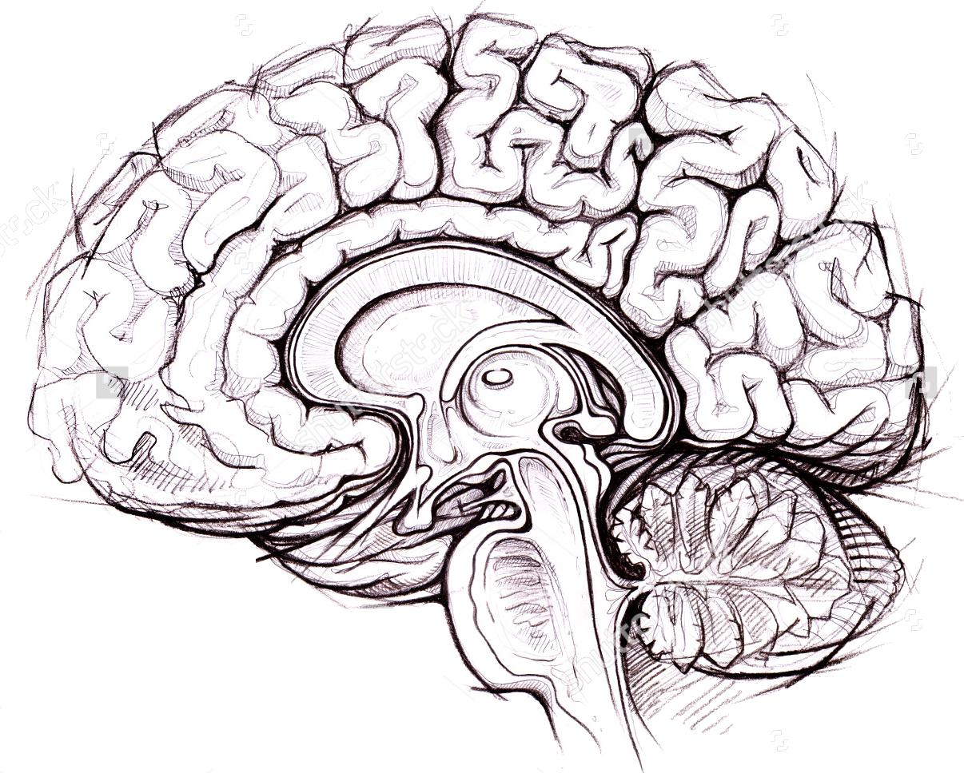
Parts of the Brain
Forebrain
Midbrain
Pons
Medulla
Notes:
Image source Gray’s anatomy Fig 677

Slide 30
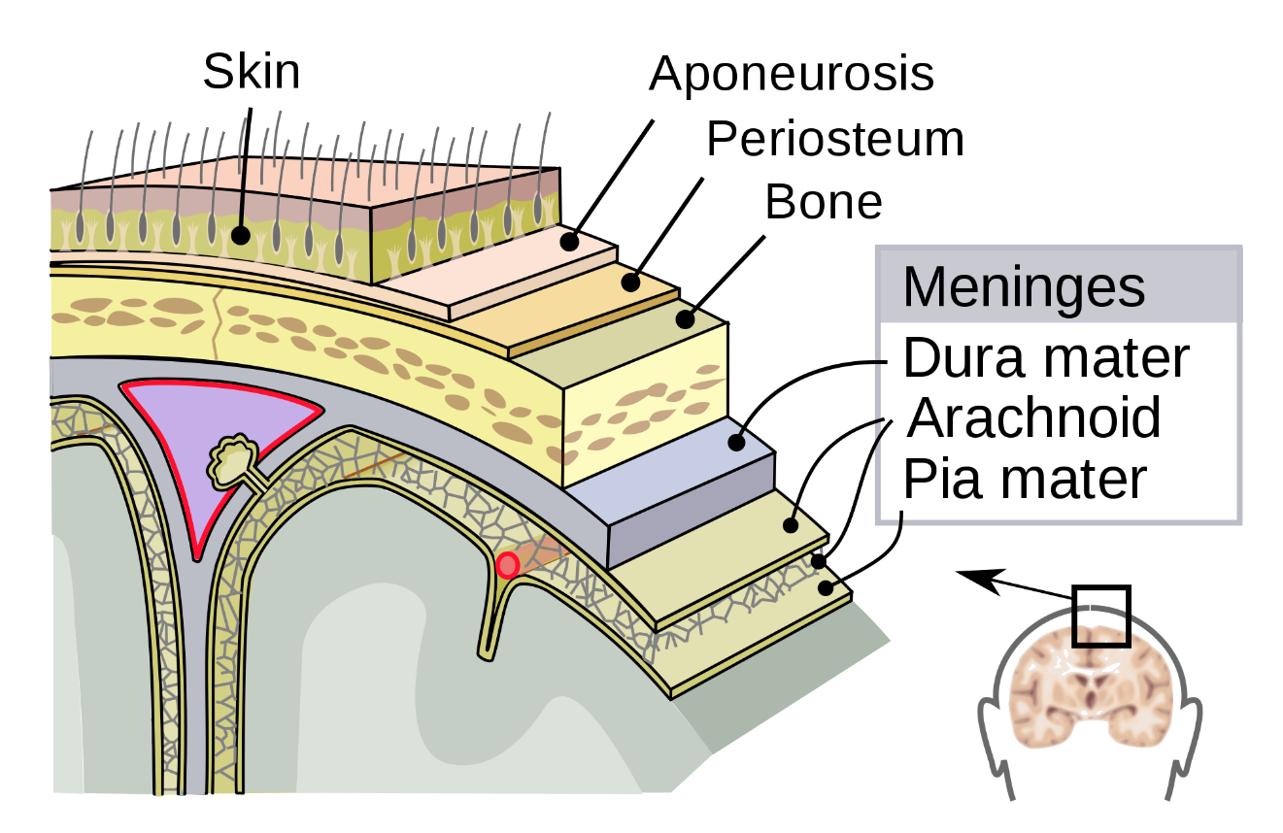
Parts of the Brain: The Meninges
The meninges are a three layered skin covering the central nervous system. It’s layers are the dura (the “hard one”), the arachnoid (the “spiderous”) and the pia (the “soft one”).
Meningitis is when the meninges become infected and inflamed. Usually a bacterial disease (meningiococcus) which can be very serious.
The arachnoid also reabsorbs cerebro-spinal fluid which is generated in the brain’s ventricles.
Notes:
Image source Gray’s anatomy Fig 677

Slide 31
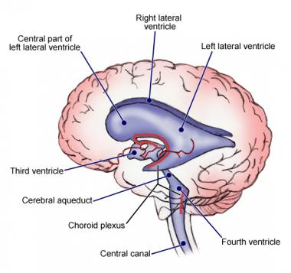

Parts of the Brain: Ventricles
The brain contains a number of cavities known as “ventricles” which are filled with cerebro-spinal fluid (CSF).
The CSF is actually secreted by choroid plexus. It circulates through the ventricles to the spinal cord and is absorbed by the arachnoid, one of the layers of the meninges.
Blockage of CSF circulation through the ventricles can lead to severe swelling of the ventricles, known as hydrocephalus (Greek for “water head”)
Notes:
Image source Gray’s anatomy Fig 677

Slide 32
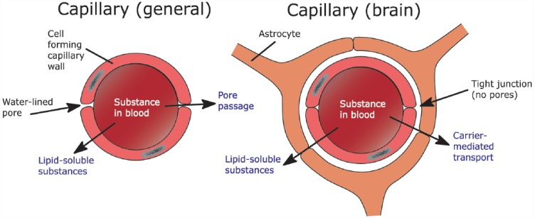
Parts of the Brain: The Blood-Brain Barrier
The capillaries (network of tiny blood vessels) in most of the body are slightly porous, allowing nutrients to flow freely from the blood serum to the surrounding tissue.
Brain capillaries have no pores, and the exchange of substances between brain and blood is actively regulated by carrier proteins produced and controlled by astrocytes.
This ensures that levels of substances abundant in food (salts, amino acids) which have key roles in brain function cannot change rapidly depending on what and when you eat. It also keeps many drugs and poisons out of the brain.
However, fat soluble substances, including alcohol or cannabis, can diffuse through the blood-brain barrier.
Notes:
Image source Gray’s anatomy Fig 677

Slide 33
Cortex
Cortex is subdivided into two hemispheres, each comprising four “lobes”
  Frontal lobe (movement, cognition)
  Parietal lobe (touch, spatial orientation and attention)
  Occiptial lobe (vision)
  Temporal lobe (hearing, object recognition, memory)
Human cortex has prominent ridges (gyri) and grooves (sulci)

Slide 34
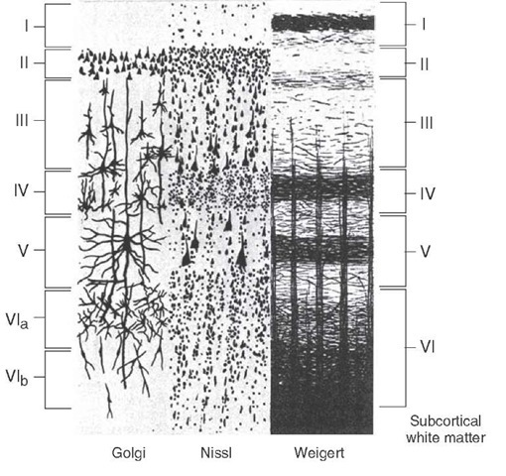
Cortex
Think of cortex of a “sheet” of nerve cells, about 2 mm thick, covering an area of 2,500 cm² , “crumpled up” to fit into the skull.
Each mm³ of the cortical sheet contains about 100,000 neurons.
(-> total cortical neurons ~50 billion)
The neurons come in different “types”, so called pyramidal or stellate neurons, or basket or granule cells, for example, and they are arranged in six “layers”, where different layers have somewhat different functions and connectivity.

Slide 35
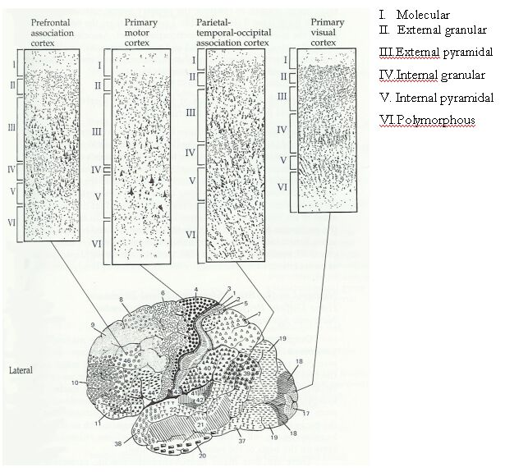
“Brodmann” Areas
Corbinian Brodmann, 1909.
52 different areas delineated based on “cytoarchitectonic” differences of different regions of cortex (from just a single subject).
(Cytoarchitecture just means cellular structure)
Notes:
Image source Gray’s anatomy Fig 677

Slide 36
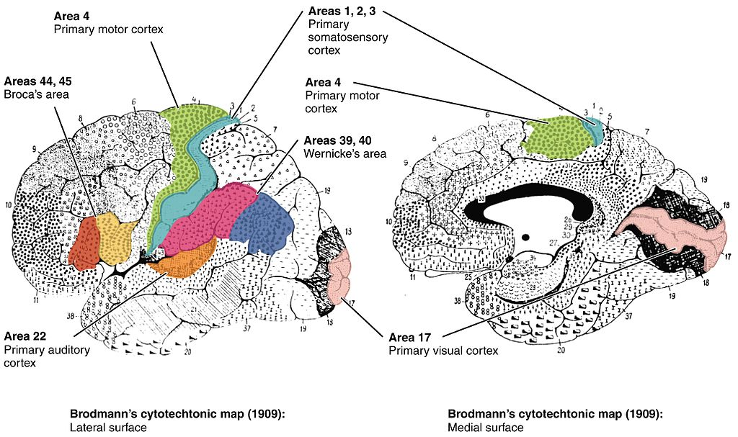
“Brodmann” Areas
Brodmann’s cytoarchitectonic areas correlate very well with functional specializations identified later. For example, areas 1-3 are “primary somatosensory cortex”, area 17 is primary visual cortex.
Area 17 (visual cortex) has a very prominent layer IV, Area 4 (primary motor cortex) has almost no layer IV.
Notes:
Image source Gray’s anatomy Fig 677

Slide 37
Note that, just as in the spinal cord, where sensory information arrives at the back and motor output goes out the front, in the cortex, sensory processing areas are mostly found in the posterior half, and motor control and decision making structures are more in the anterior half.

Slide 38

Parts of the Brain: Thalamus
Thalamus
The Thalamus is an “obligatory relay” between sensory input and cortex. That means (with the exception of smell), sensory afferents from all the senses synapse in thalamus and thalamic neurons then connect to cortex.
But cortex also sends nerve fibres back down to thalamus, perhaps to send signals of expectation or selective attention to thalamic relay neurons, so that thalamus sends only the most relevant information to cortex.
Thalamic activity is also thought to be very important in mediating sleep and in directing attention.
Notes:
Image source Gray’s anatomy Fig 677

Slide 39
Parts of the Brain: Hypothalamus
Hypothalamus
Greek “hypo” means “below”.
The hypothalamus is an ancient brain structure that controls many important bodily functions, such as appetite, thirst, blood pressure, body temperature, sleep-wake (circadian) rhythms, the regulation of the levels of growth hormones, stress hormones and sex hormones, etc…
Notes:
Image source Gray’s anatomy Fig 677

Slide 40
Parts of the Brain: Pituitary Gland
Pituitary
The pituitary is perhaps the most important hormone secreting gland of the body.
It is connected to the hypothalamus via the pituitary stalk, and the hypothalamus directly controls it’s function.
It gets inputs from the hypothalamus to control hormone levels involved in functions as diverse as reproduction, growth, thirst or stress levels.
Notes:
Image source Gray’s anatomy Fig 677

Slide 41
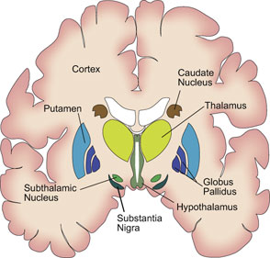
Parts of the Brain: Basal Ganglia
Clumps of (often many thousands of) neurons can be referred to as “ganglia” or “nuclei”.
The Basal Ganglia form feedback circuits, which start in frontal and prefrontal parts of cortex and pass through the basal ganglia to thalamus and back to cortex.
Parts of the Basal Ganglia include the Caudate and Putamen (together known as the Striatum), the Globus Pallidus, the Subthalamic Nucleus and the Substantia Nigra.
The Basal Ganglia are hugely important in action selection, habits, even addiction.
Notes:
Image source Gray’s anatomy Fig 677

Slide 42
Parts of the Brain: Cerebellum
The cerebellum (Latin for “little brain”) is another brain area involved in motor control.
It receives diverse sensory inputs from all over the brain and is thought to learn to associate that with motor output patterns in order to make motor execution “smooth” and automatic after practice.
Damage to the cerebellum makes movements slow and clumsy (ataxia and apraxia), or can cause disturbed balance.
Its role in cognition and emotion is hotly debated.
Cerebellum
Notes:
Image source Gray’s anatomy Fig 677

Slide 43
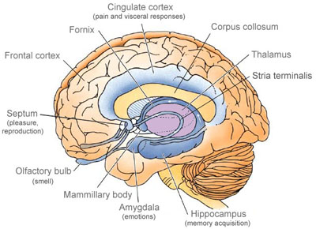
Parts of the Brain: The Limbic System
A group of structures situated around the “edge” (Latin: “limbus”) of the cortex are commonly called the “limbic system”. Key members of the limbic system include the amygdala, hypothalamus, thalamus, hippocampus and cingulate cortex.
Limbic structures have long been suspected to be both “old” in evolutionary terms as well as important in “emotional” responses, including fear, anger, pleasure and arousal.
Notes:
Image source Gray’s anatomy Fig 677

Slide 44
Key Summary “Take Home” Messages
The nervous system controls your muscles and your glands, thereby controlling all sorts of stuff, from how moist to keep your eyeballs through your tear glands to deciding which courses you will choose next semester, or who you fall in love with.
The brain consists of many parts which are thought to have evolved sequentially, with more “modern” structures both allowing new, additional functions and exercising additional control over old functions. Example of old structures: spinal cord with its reflexes and simple motor patterns, or hypothalamus with its control of hormones and basic drives. Example of new structure: (neo)cortex which is enormous in humans and which is critical in analytical or creative thinking or language.
Your cortex and your limbic system may have quite different “opinions” about a particular situation.
The brain’s parts are subdivided in symmetric, hemispheric pairs and are richly interconnected by fiber bundles.
They contain huge numbers of neurons which process information using partly electrical and partly chemical signalling, which we will study in great detail in the next lecture.
Notes:
Image source Gray’s anatomy Fig 677

